Slide 1
Sustainable Growth Subcabinet​
AGENDA​
Virtual Open Forum
Friday, June 12th, 2026
Public Forum: 9:30 – 11:00 am
______________________​

Slide 2
AGENDA
SGSC Open Forum – June 12, 2026
9:30 Welcome – Roll Call ​
9:35 Sustainable Growth Program & Policy Implementation
9:40 2026 Session – Legislative Highlights
9:50 FY26 Agency Highlights
10:45 Sustainable Growth Awards
10:50 Closing Round
11:00 Adjourn Meeting

Slide 3
SUSTAINABLE GROWTH SUBCABINET MEMBERS​
MDP Secretary Rebecca Flora, Chair​
DHCD Secretary Jake Day, Vice Chair (Julia Glanz)​
MDA Secretary Kevin Atticks (Michelle Cable)​
DBM Acting Secretary Jake Weissmann (Alison Verba, Christina Perrotti)​
Commerce Secretary Harry Coker (Jim Palma)​
MDEM Secretary Russ Strickland (Mike Hinson) ​
MDE Secretary Serena McIlwain
(Suzanne Dorsey)​
DGS Secretary Atif Chaudhry
(Wendy Scott-Napier) ​
Health Secretary Meena Seshamani (Katie Bhide)​
Higher Education Acting Secretary Elena Quiroz-Livanis
(Shaunda Villones, Dan Schuster)​
Labor Secretary Portia Wu (Ashley Sharp)​
DNR Secretary Josh Kurtz
(Leah Sheppard, Paul Peditto)​
MDOT Secretary Katie Thomson
(Geoff Anderson)​
MEA Director Kelly Speakes-Backman (Jenn Aiosa)​
Assist Sec. of the DHCD Office of Neighborhood
Revitalization: Kari Snyder (Kevin Baynes)​
Governor’s Deputy COS: Chichi Nyagah-Nash
(Meghan Conklin) ​
National Ctr for Smart Growth at UMD:
Dr. Kathryn Howell (ex-officio) (Nick Finio)​
​
(designated alternates) ​

Slide 4

Q&A
This Open Forum is being recorded. Send questions or tech issues to Mary Daughton in the chat.
Please ask questions in the Q&A. If time permits, the Subcabinet will try answer questions
at the end of the public forum.
Third party AI assistants are prohibited

Slide 5
Sustainable Growth Program & Policy Implementation
Sustainable Growth Subcabinet Open Forum, June 2026

Slide 6
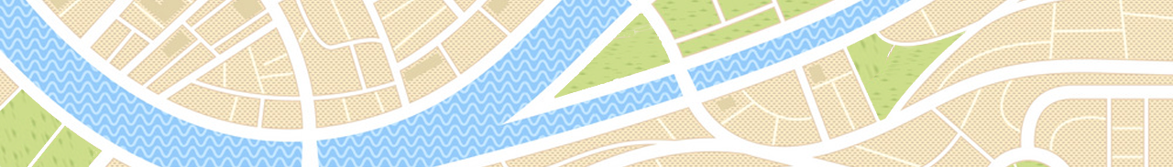
Sustainable Growth Program & Policy Implementation
Sustainable Growth Common Definition
A THRIVING community is one where people of all generations can live healthy and fulfilled lives, and can grow, flourish and prosper, now and in the future
Peak District National Park
  Sustainable Growth is a strategic approach to land use policy and development practices that equitably consider
  economic, social and environmental implications on
  existing and future generations.

Slide 7
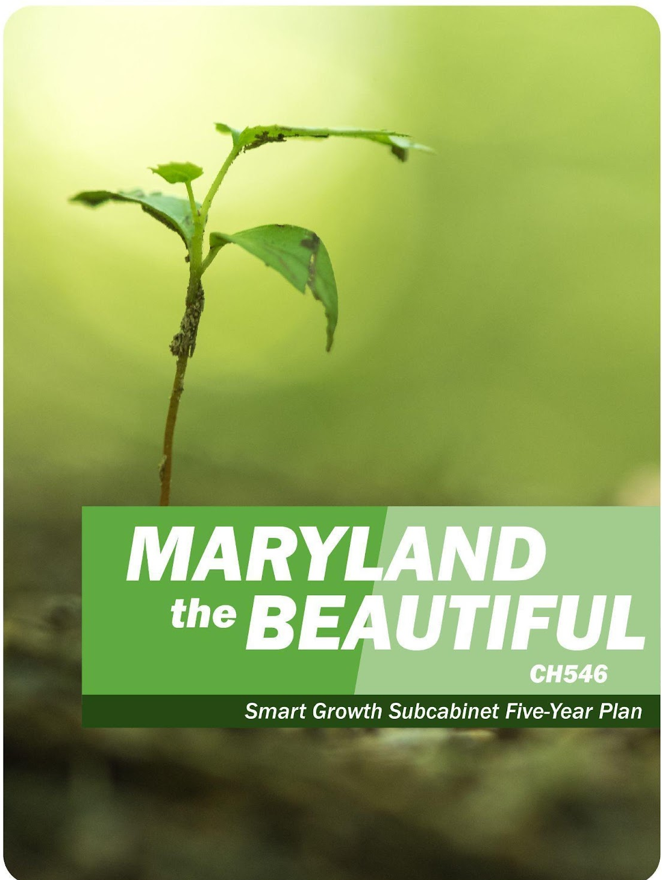
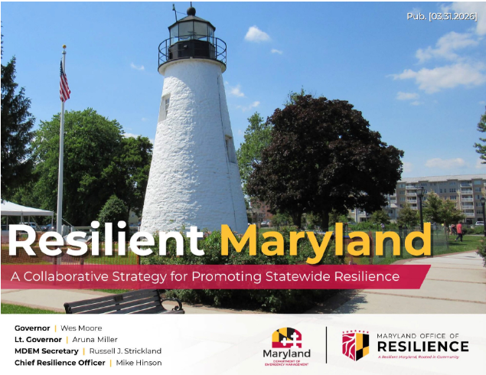
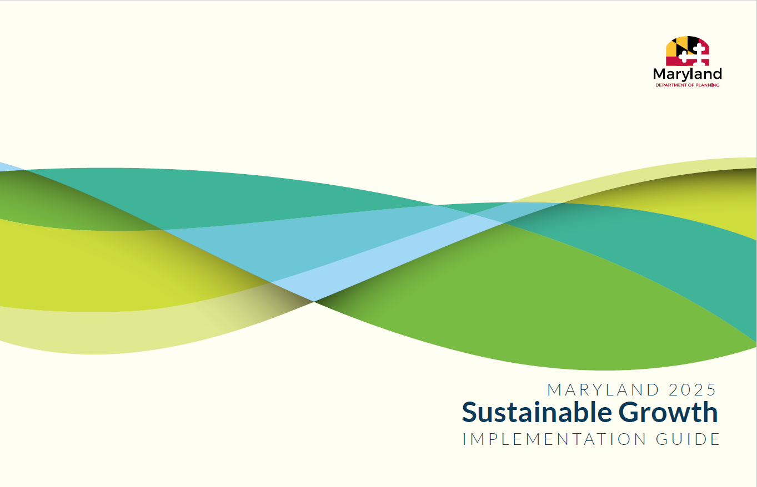
Sustainable Growth Program & Policy Implementation
SGSC Oversight and Approvals - FY26 Highlights
The SGSC through the staff support of SG Coordinating Committee provides a forum for state agency consultation and collaboration on:
Maryland Sustainable Growth Awards Program
Maryland the Beautiful Act Annual Report
Aligning Transit Oriented Development (TOD) and Sustainable Communities (SC) designations
Statewide Resilience Strategy
Sustainable Growth Policy & Planning Principles Implementation Guide​
  Published Sustainable Growth Implementation Guide
  Annual review cycle
Comprehensive Plan Element to Principle Alignment
  Legislatively aligned local comprehensive plan elements with Planning Principles
  Incorporated state plans, data sharing, and technical assistance into the process

Slide 8
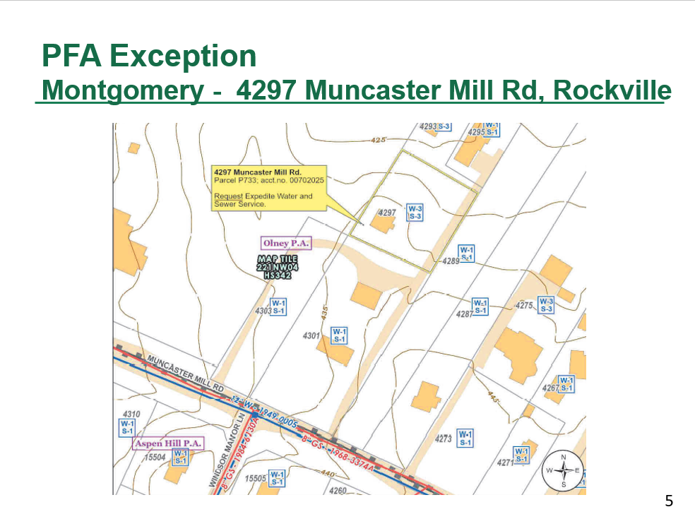
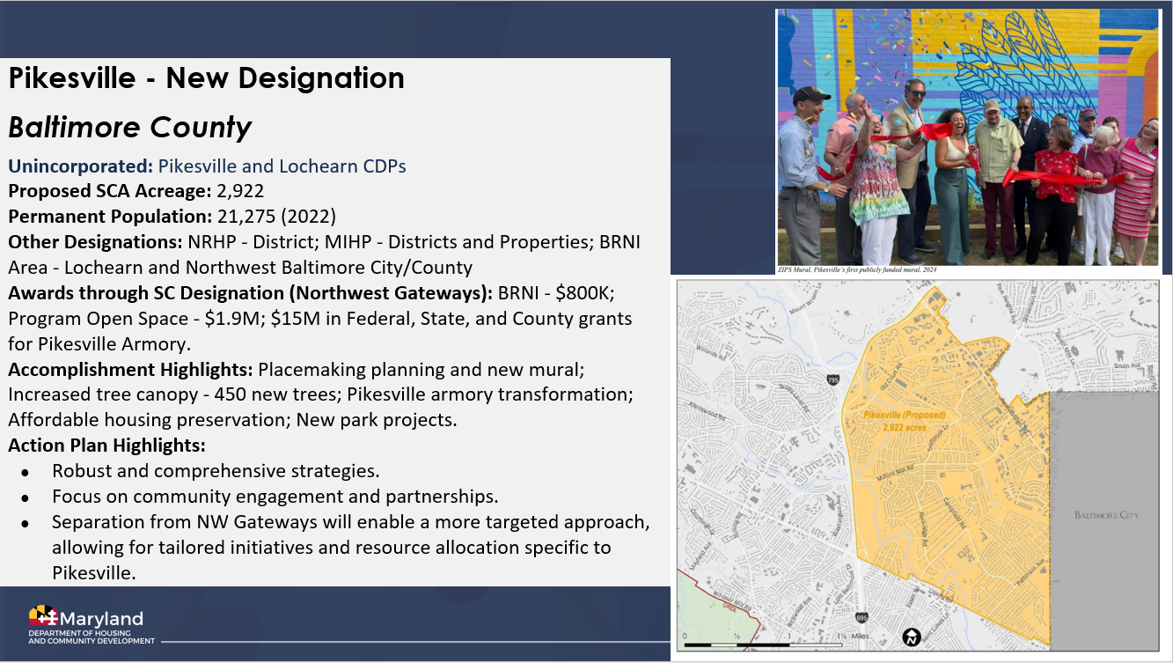
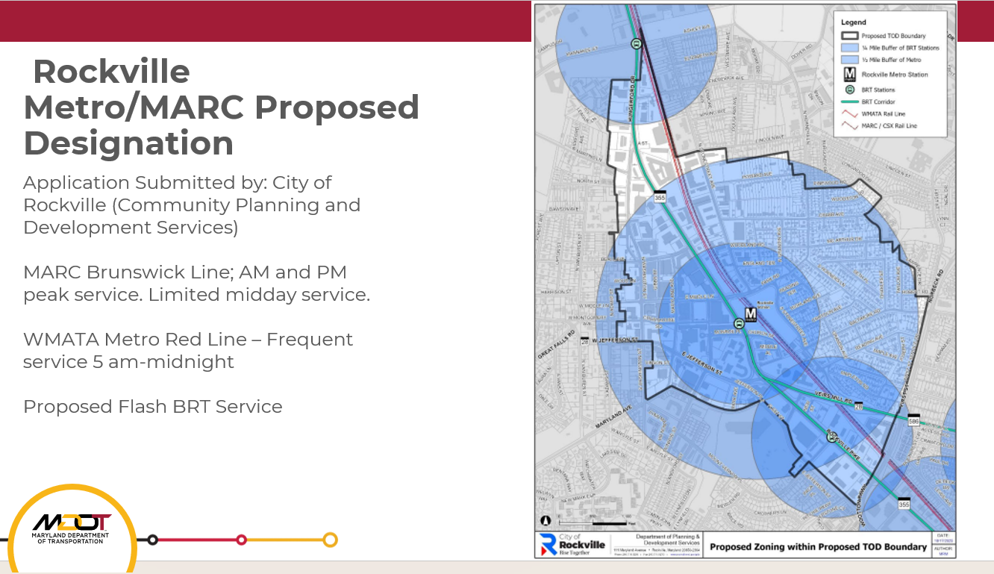
Sustainable Growth Program & Policy Implementation
SGSC Oversight and Approvals - FY26 Highlights
PFA Exceptions​*
  Five (5) PFA Exceptions​ granted for a total of $2,000,000
  ​MDE sponsored exceptions; all due to public health & safety
Sustainable Community Renewals*​
  Six (6) SC Renewals and One (1) Boundary Modification
Sustainable Community Designations​
  Four (4) SC Designations, Two (2) Renewals with Boundary Modifications
MDOT Transit-Oriented Development (TOD) Designations
  Two (2) TOD Designations
* Sustainable Growth Coordinating Committee designated approvals

Slide 9
2026 Session – SGSC Legislative Highlights
Sustainable Growth Subcabinet Open Forum, June 2026

Slide 10
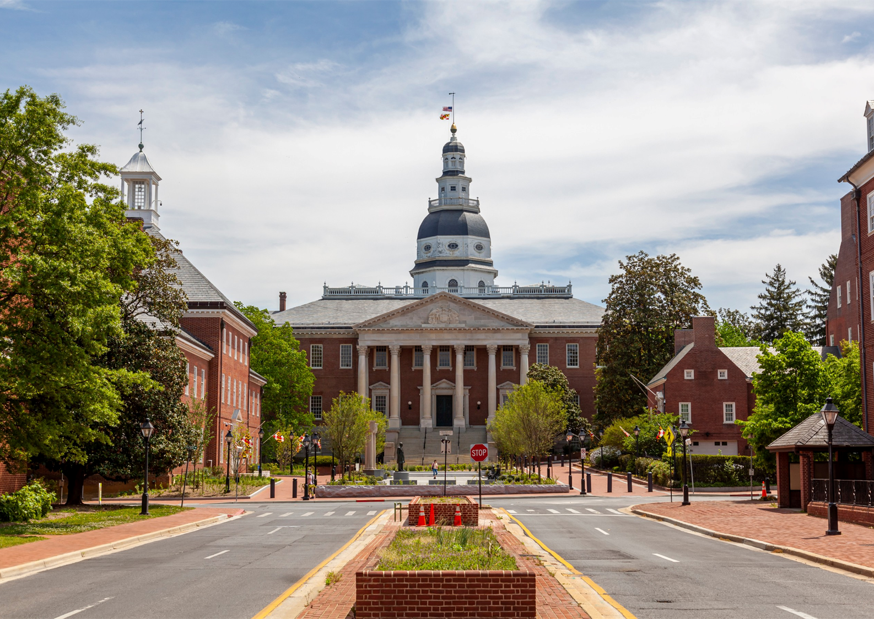
2026 Session Recap
Sustainable Growth Policy
Housing & Economic Development
  HB 894 - Transit and Housing Opportunity Act
  HB 898/SB 388 – DECADE Act
  HB 548/SB 325 - Housing Certainty Act
  HB 161/SB 58 - Property Tax Credit - Retail Service Station Conversions
  HB 135 - Economic Development - Tax Increment Financing - Noncontiguous Areas
  HB 461 - Rural Readiness Program and Rural Maryland Capacity Building Fund - Establishment
Energy
  HB 1532 – Utility RELIEF Act
Natural Resources
  HB 254 - Supporting Inclusive Community Adaptation Act

Slide 11
2026 Session Recap
Notable Studies, Reports, and Task Forces
HB 1137 – Bring Back Main Street Act
  DHCD studies residential-in-commercial-zone (RICZ) laws, statewide legislation requiring localities to allow multifamily residential/mixed-use developments in some commercially zoned areas
HB 1142 – Task Force to Modernize County and Municipal Revenue Structures
  Group studies current county and municipal revenue structures and makes recommendations regarding "the authority county and municipal governments to increase sources of revenue”
SB 282 – Budget Bill FY 27. Two reports of interest delegated to MDP
  Permitting Study: Regarding permits that impact the business community, including identifying places where permitting overlaps agencies unnecessarily, a review of the processing time to issue permits, and recommendations for State MFR metrics.
  Land Value Tax and TOD: Regarding the feasibility, fiscal impacts, and policy design for applying a split-rate or land value tax within defined areas adjacent to rail stations served by MARC, MTA Metro SubwayLink, MTA Light RailLink, or the Purple Line.

Slide 12
FY26 SGSC Agency Highlights
MDOT – DNR – Commerce – DHCD – DGS – MDEM – MDA – MDE – MHEC – MDP
Sustainable Growth Subcabinet Open Forum, June 2026

Slide 13
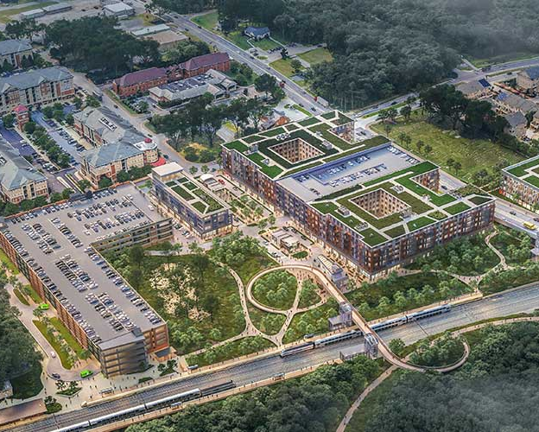
MDOT Updates for the Sustainable Growth Public Forum
June 12, 2026
Geoff Anderson
Chief, Office of Planning, Programming, and Project Delivery

Slide 14
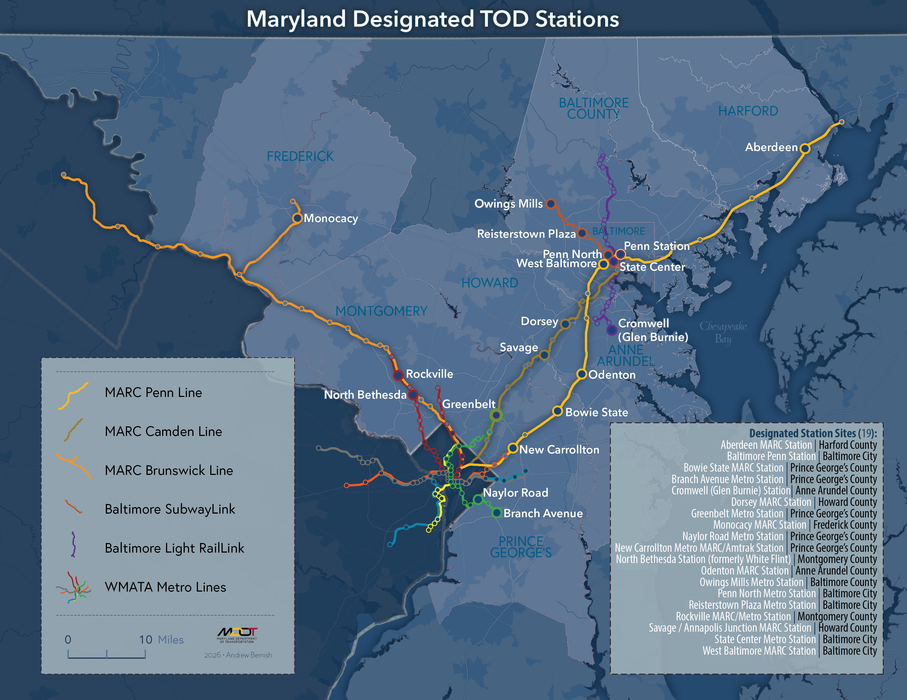
TOD Designation Program
Successes:
Strong interest from locals since launching new process – 5 new designations, 10+ sites in pipeline
MDOT's TOD Fund has been positive incentive for designation
Good information sharing opportunity for State and locals
Sustainable Communities alignment
Challenges:
Locals are limited in staff capacity to work on applications
Private stakeholders unsure of best way to advocate for local designation
New application process launched June 2024
MDOT administers application process and SGSC review group; SGSC issues resolutions approving/denying designations
5 new designations so far – Penn North, West Baltimore, Monocacy, Rockville and Cromwell

Slide 15
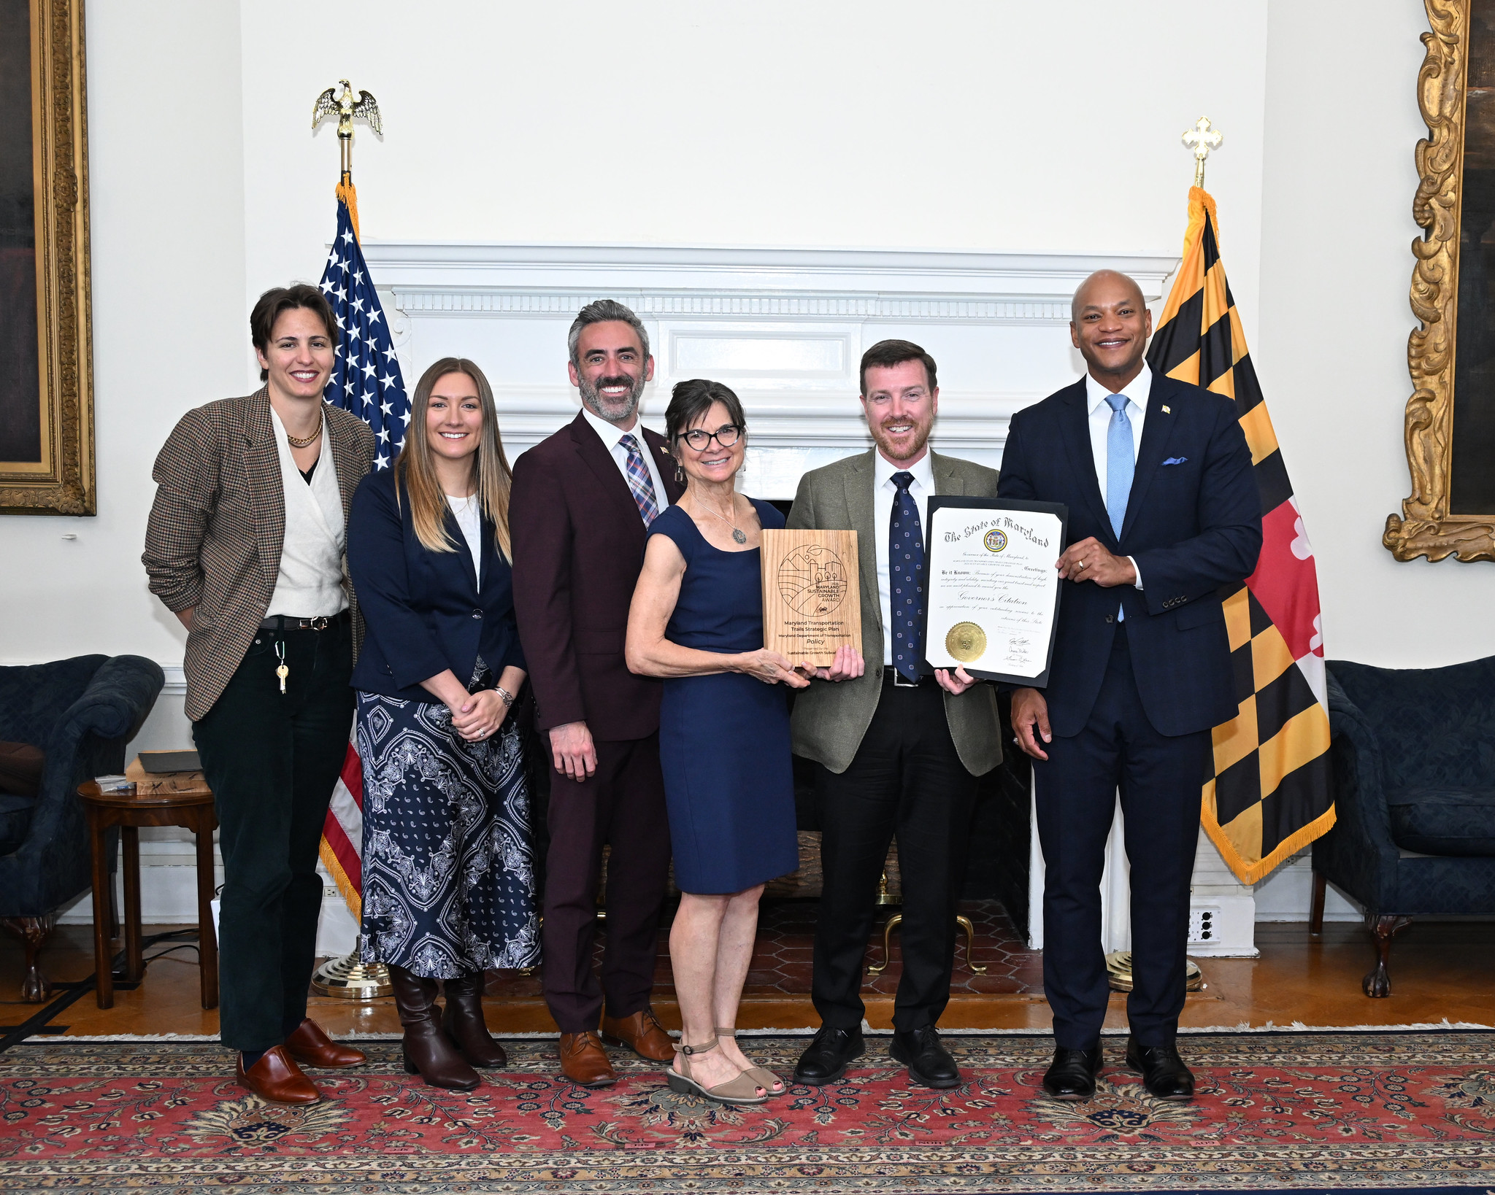
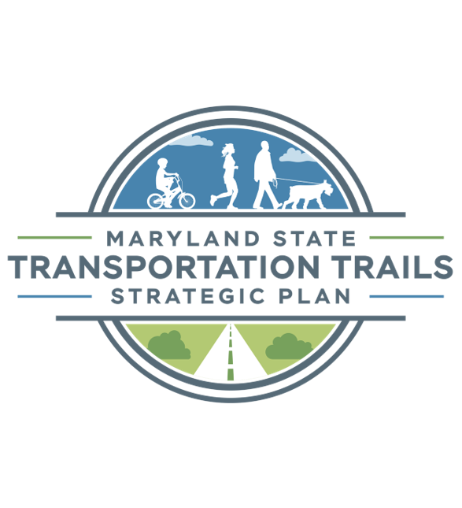
Sustainable Growth Award
The Maryland State Transportation Trails Strategic Plan recently was awarded the Sustainable Growth Award for Policy
Visit our website for more information on the Plan: www.mdot.maryland.gov/trailsplan
Photo of the Sustainable Growth Award Ceremony.
Left to right: Meg Young (MDOT), Aviva Klugh (MDOT), Secretary Jake Day (DHCD), Secretary Rebecca Flora (MDP), Assistant Secretary Joe McAndrew (MDOT, Governor Wes Moore

Slide 16
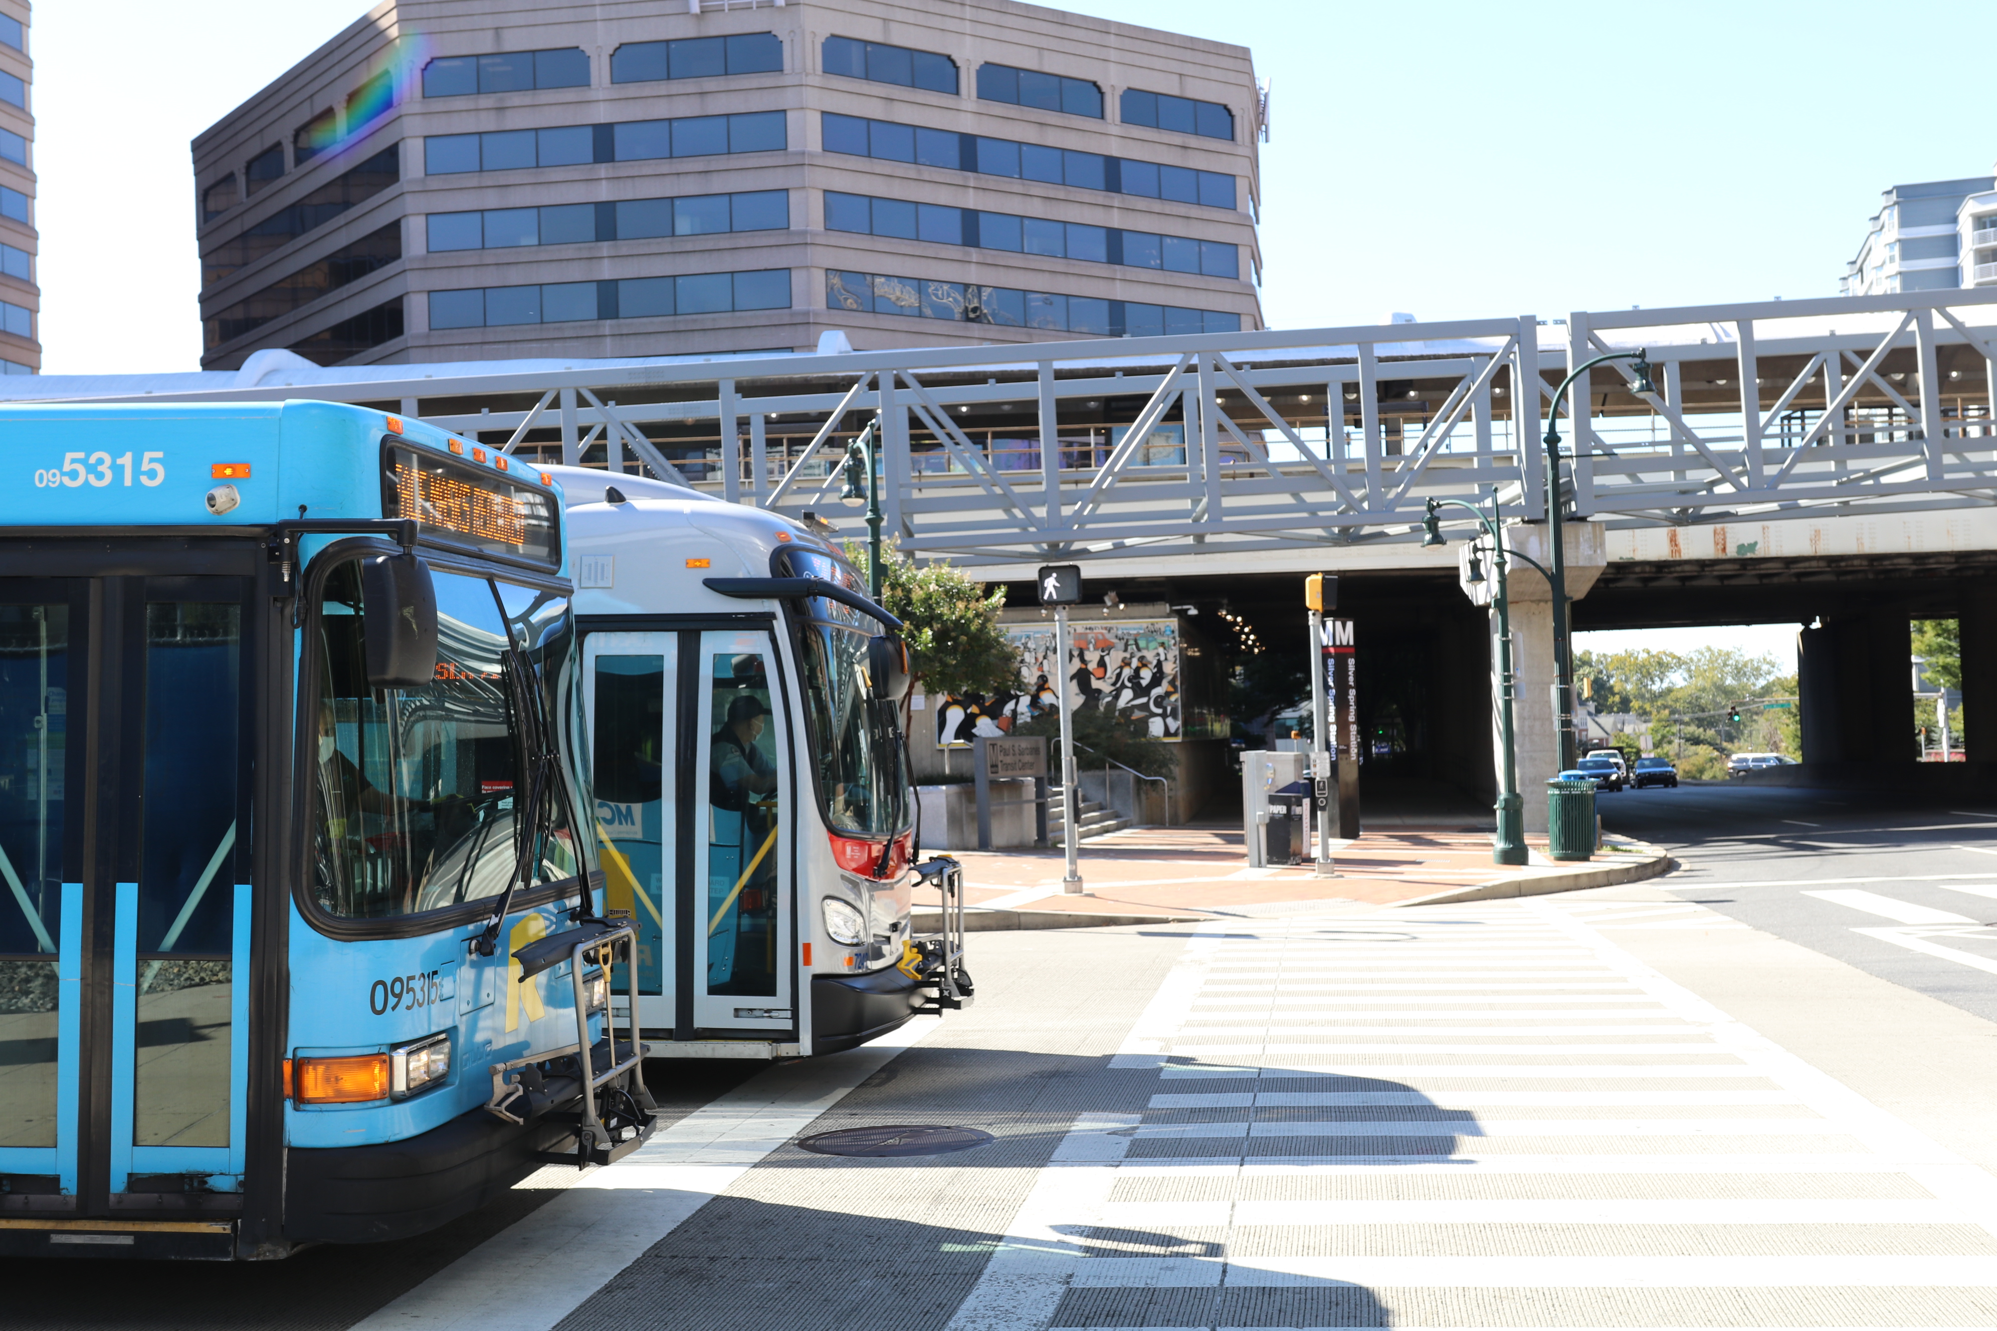
ANY QUESTIONS?
GEOFF ANDERSON
Chief OPPPD
ganderson4@mdot.Maryland.gov

Slide 17

Department of Natural Resources
Sustainable Growth Open Forum
6/12/2026

Slide 18
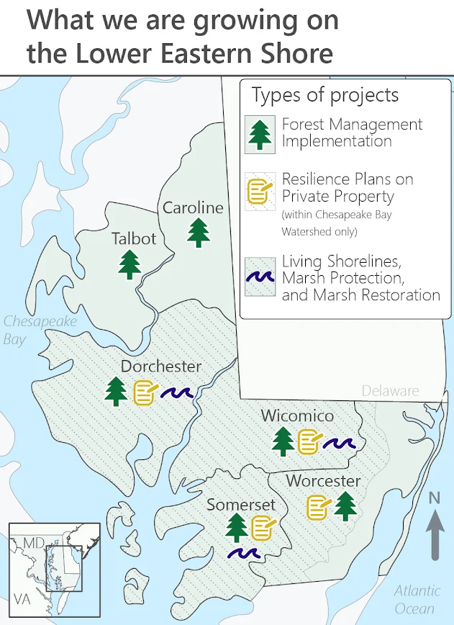
Department of Natural Resources
DNR Launched Roots For Resilience Initiative
Focused on adapting the Eastern Shore to the impacts of climate change and restore forests and coastal habitats
Project goals:
Restore tidal connectivity of 400 acres of marshes
Restore 200 acres of tidal wetlands
Install living shorelines to protect 400 acres of tidal marshes
Restore 500 acres of forest habitat and improve forestry management on 1,000 acres
Supported by $42.5 million from the EPA
Notes:
DNR Launched Roots For Resilience Initiative
This initiative is focused on helping MD’s Eastern Shore adapt to the impacts of climate change and restore forests and coastal habitats.
The agency will invest in nature-based solutions including tree planting, sustainable forest management, coastal wetland restoration, and living shoreline projects.
Project goals:
Restore tidal connectivity of 400 acres of marshes.
Restore 200 acres of tidal wetlands.
Install living shorelines to protect 400 acres of tidal marshes.
Restore 500 acres of forest habitat and improve forestry management on 1,000 acres.
This initiative is supported by $42.5 million in federal grant funding from the US Environmental Protection Agency.

Slide 19
Department of Natural Resources
Grants Gateway Applications Open July 15, 2026
Grants Gateway provides funding for projects that improve water quality in local waterways, increase communities’ resilience, strengthen local economies, and develop environmental stewards.
Important dates:
Applications open: July 15 2026
Informational webinar: August 20 2026
Application deadlines: September - December 2026
Awards: July 2027
Grants are made possible with funding from the Chesapeake and Atlantic Coastal Bays Trust Fund, NOAA, EPA’s Chesapeake Bay Program
Learn more at: https://dnr.maryland.gov/ccs/pages/funding/grantsgateway.aspx
Notes:
Grants Gateway Applications Open July 15, 2026
DNR connects Maryland communities with funding for projects and programs that improve water quality in local waterways, increase communities’ resilience to storms and climate change, strengthen local economies, develop environmental stewards, and benefit the general boating public.
Important dates:
Request for Solicitation opens: July 15, 2026
Informational webinar: August 20, 2026
Application deadlines are grant program specific and range from September - December, 2026
Applicant notification of award July 2027
Grants are made possible with funding through the Chesapeake and Atlantic Coastal Bays Trust Fund, the National Oceanic and Atmospheric Administration, and the U.S. Environmental Protection Agency’s Chesapeake Bay Program
Learn more at: https://dnr.maryland.gov/ccs/pages/funding/grantsgateway.aspx

Slide 20
Department of Natural Resources
New State Laws Encourage Coastal Resilience and Native Tree Planting
Supporting Inclusive Community Adaptation Act
Eases upfront costs for shoreline restoration projects for private property owners
Expands the Resilience Through Restoration program, which supports the design and construction of nature-based flood mitigation projects
Facilitates community participation and enhances state tools for climate adaptation planning
Tree-Mendous Maryland
Expanded to support the ongoing maintenance of native trees, stewardship, and broader community forestry activities
The program has helped supported tree planting in more than 3,000 communities, parks, and schools
Notes:
New State Laws Encourage Coastal Resilience and Native Tree Planting
Governor Moore signed the Supporting Inclusive Community Adaptation Act into law on April 14, which eases upfront costs for shoreline restoration projects for private property owners. The law also codifies and expands the Resilience Through Restoration program, which supports the design and construction of nature-based flood mitigation projects. Finally, the law also allows the state to facilitate community participation in planning projects, helps local governments use state tools in climate adaptation planning, and uses public lands to model nature-based solutions for climate change resilience.
The 2026 General Assembly expanded the Tree-Mendous Maryland program to support the ongoing maintenance of native trees, stewardship, and broader community forestry activities. Tree-Mendous Maryland has helped supported tree planting in more than 3,000 communities, parks, and schools.

Slide 21
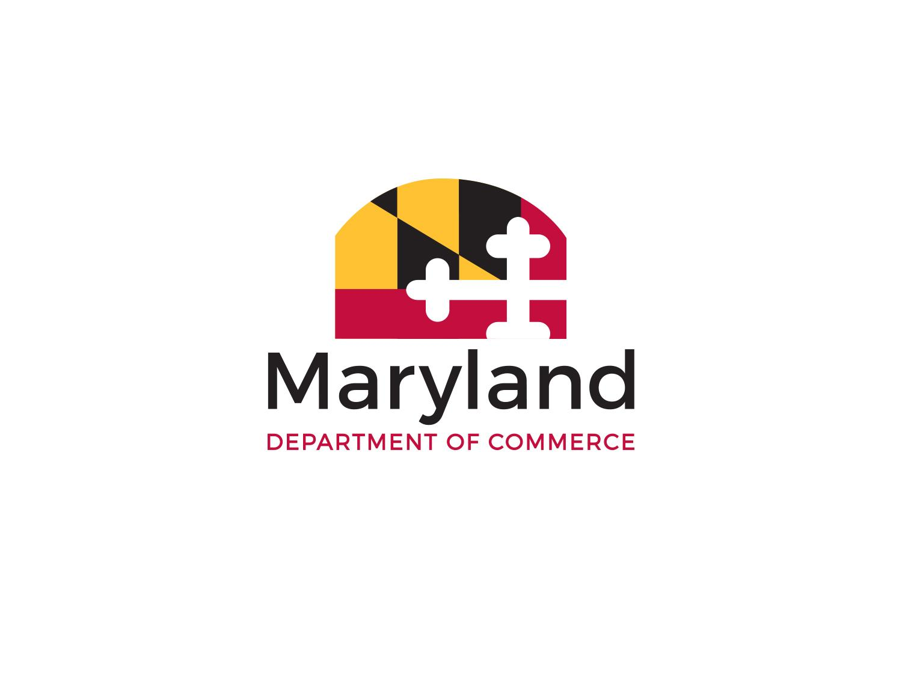
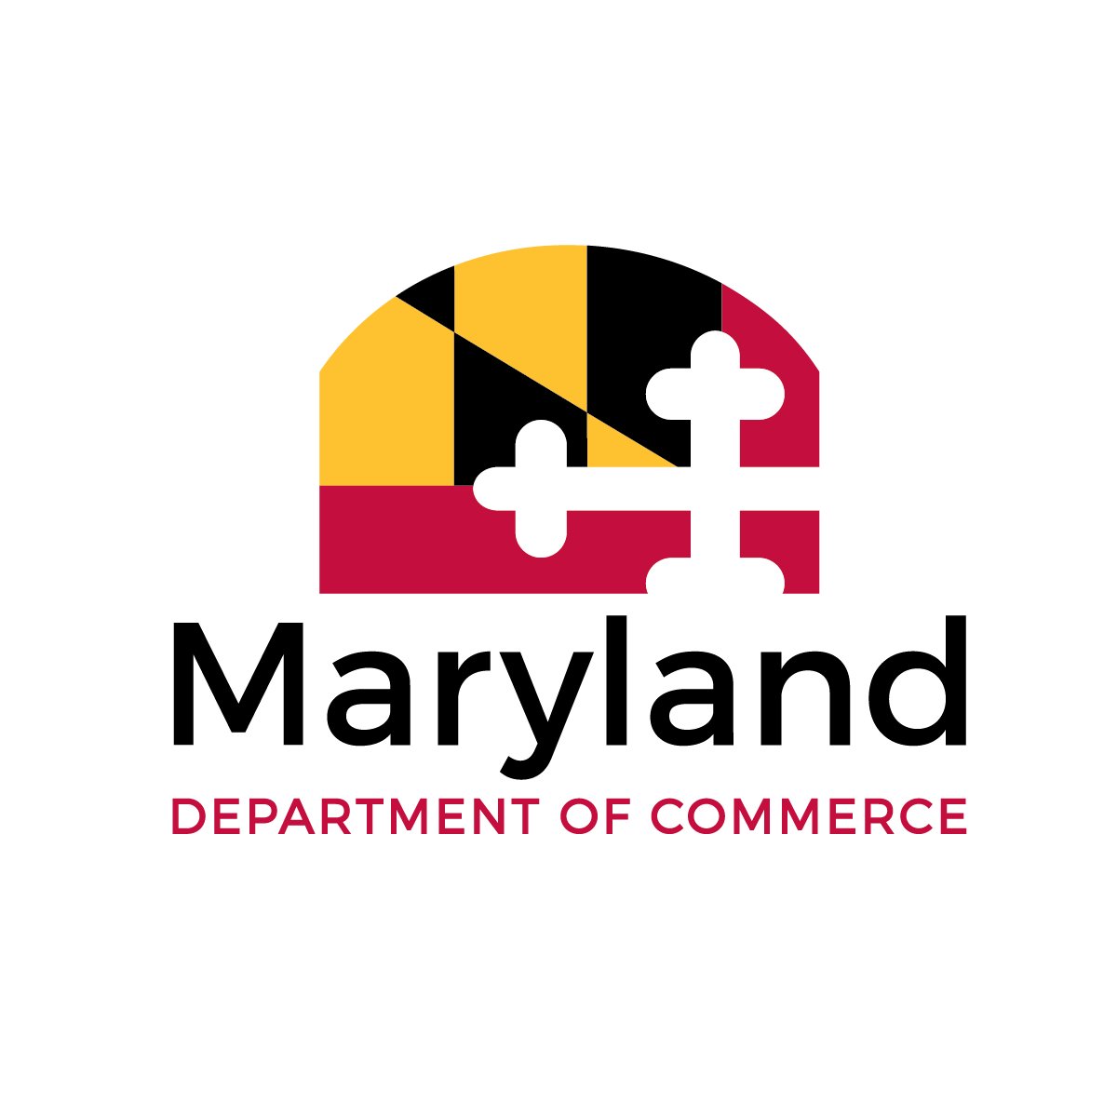
Department of Commerce

Slide 22



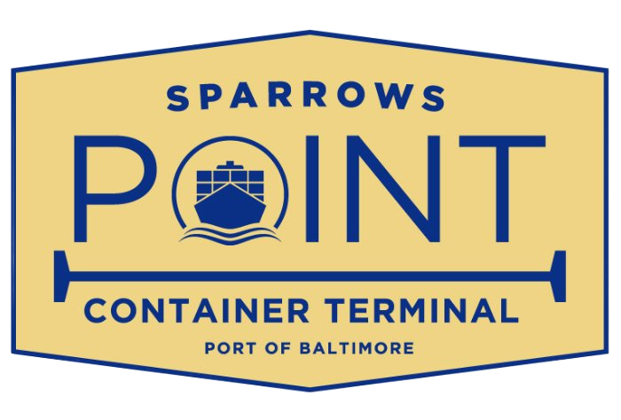




Recent Wins

Slide 23
DECADE Act of 2026
Extends and modernizes the Build Our Future Grant Program and the Regional Institution Strategic Enterprise (RISE) Zone program; both of these programs also move from Commerce to MEDCO.
Moving the Sunny Day Program, also known as the Economic Development Opportunities Program Fund, to Commerce and rebranding it as the Strategic Closing Fund.
Increasing assistance to eligible businesses through the Maryland Small Business Development Financing Authority (MSBDFA)
Strengthens the Maryland Economic Development Assistance Authority and Fund (MEDAAF) by increasing the amount of assistance the state can offer to support a major economic development project.

Slide 24
FY27 Budget - Investing in
Economic Growth
No new taxes or fees
$8 million for the Western Maryland Economic Future Investment Board and the Senator George C. Edwards Fund
$8 million for the Strategic Closing Fund
Funds for Key Commerce Programs:
  MEDAAF: $17.5M
  MSAC: $33.7M
  Tourism: $20.4M
  Key Small Business Programs: $33.6 million

Slide 25
Sustainable Growth Updates
June 12, 2026

Slide 26
Housing Starts Here: Implementation Update
Activating State-Owned Land: DHCD and DGS are evaluating surplus state parcels for suitability for redevelopment as housing
Shortening Timelines:
  DHCD has implemented new software and other process improvements, speeding financing for affordable housing
  MDE and MDOT SHA have updated processes and digitized many permit applications, delivering faster approvals
Improving Coordination: DHCD’s State Housing Ombudsman has helped reduce permit delays and unstick stalled projects statewide
Incentivizing Local Action: First annual Housing Production Targets Report to be published in January

Slide 27

Reinvest Baltimore
Baltimore Vacants Reinvestment Council
17 member council with city, state, corporate and philanthropic leaders
Bi-monthly meetings to review performance goals, discuss constraints, and fortify stakeholder collaboration
Implements Reinvest Baltimore Action Plan (approved Dec 2025)
Includes 4 working groups: Delivery Chain, Finance, Economic Opportunity, and Data
Baltimore Vacants Reinvestment Initiative
$50M annually to eliminate concentrations of vacant property on block clusters
Funding partners include Balt City DHCD, MSA, MCIC & Balt City CDOs
Balt City/MSA acquire, stabilize & demolish property for future redevelopment; MCIC finances CDOs to acquire/rehab VBNs ready for market
As of April 20th: 20 BVRI CDOs have abated 39 vacant buildings
with 100 more under permit and 63 under site control.
FY27 applications closed April 1st; currently under review.

Slide 28
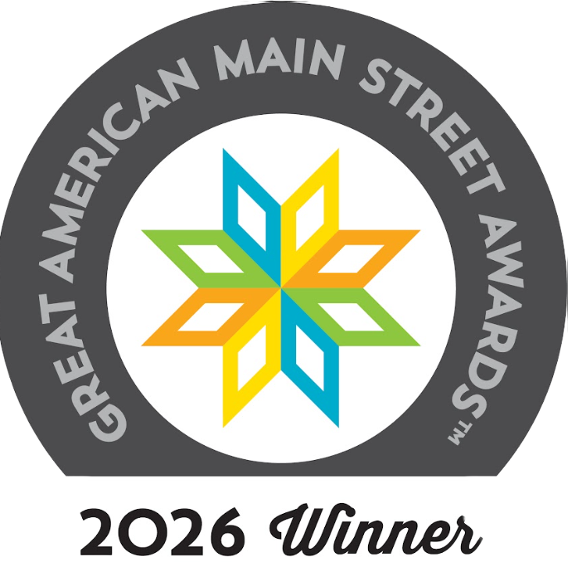
Main Street Maryland Highlights: 2025 - 2026
More inclusive tier structure: Connected > Aspiring > Designated
44 Main Street Maryland communities: 85% Designated fully accredited
First-ever mentor program: 8 expert managers < > Aspiring tier
Annual, statewide conference 400+ attendees
Great American Main Street (GAMSA) Winner 2026: Sykesville!
Connected application open now. Deadline = August 7
ANNUAL IMPACT DATA (2025):
193 businesses opened; 885 jobs; $84.4 public & private investment

Slide 29
DGS Efforts for Affordable Housing in MD
June 2026

Slide 30
Executive Order re: MD’s Affordable Housing Crisis
DGS conducted search for State-owned properties no longer needed for consideration for the development of future affordable housing
Initially reviewed 4,198 properties owned by over two dozen departments/agencies
7 departments/agencies identified 11 potential properties to be further analyzed for housing in the following counties:
  Anne Arundel
  Baltimore County & City
  Charles
  Prince George’s
  Wicomico

Slide 31
Executive Order re: MD’s Affordable Housing Crisis
One of the 11 properties has been placed on the market:
  2100 Guilford Avenue (Baltimore City)
  2.21 acre former State office building
  AH redevelopment bids received in May and will be reviewed and assessed in the near future
  Community outreach and feedback pivotal to a successful project
  Will be used as a template for the offering of other properties
  Selection of developer expected in late 2026/early 2027

Slide 32
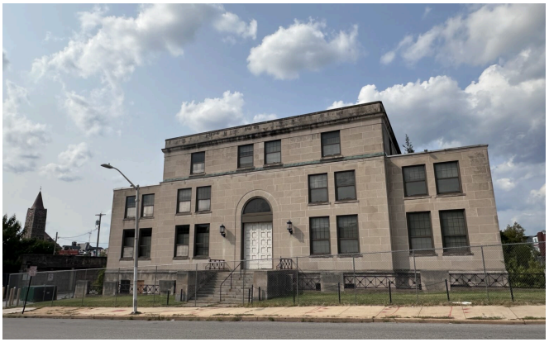
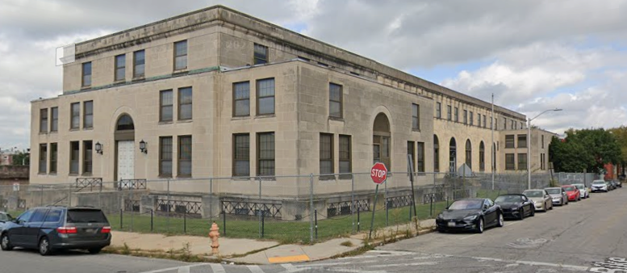
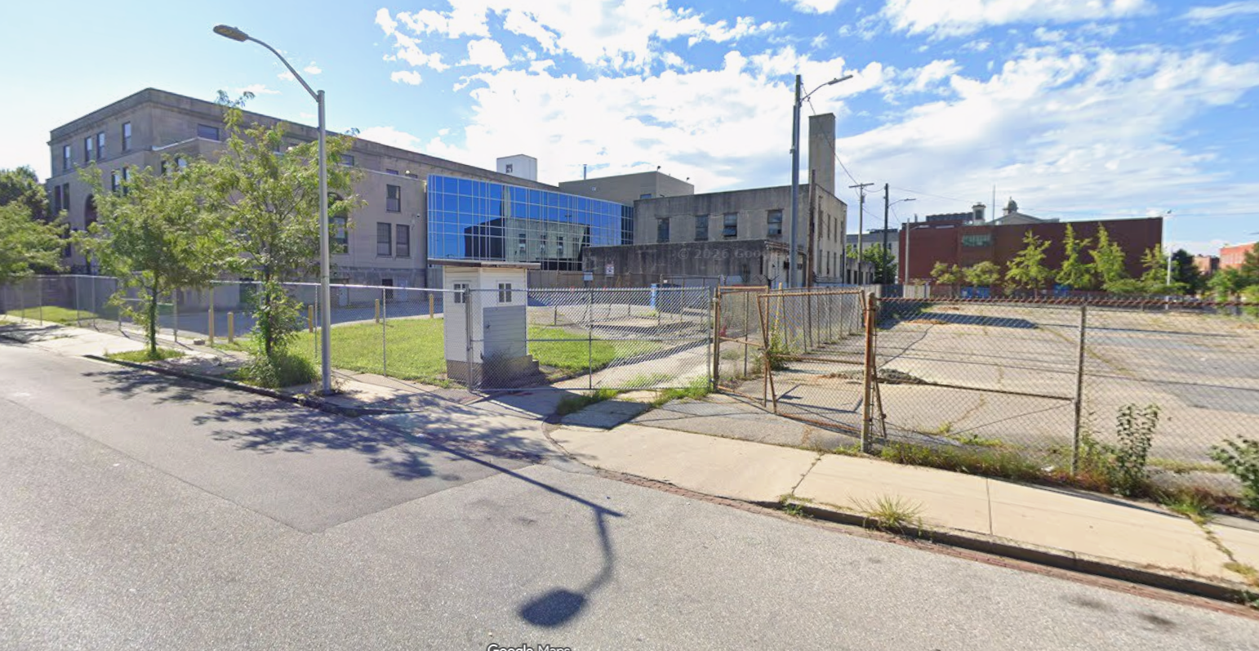
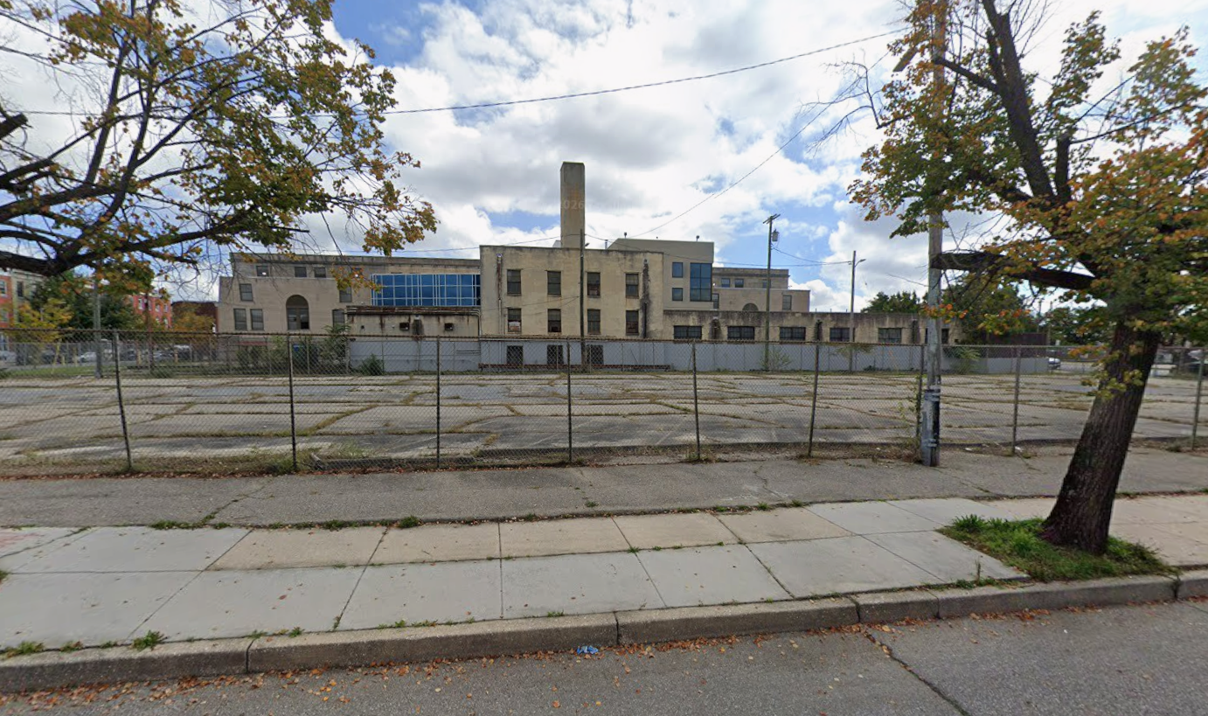
Executive Order re: MD’s Affordable Housing Crisis

Slide 33
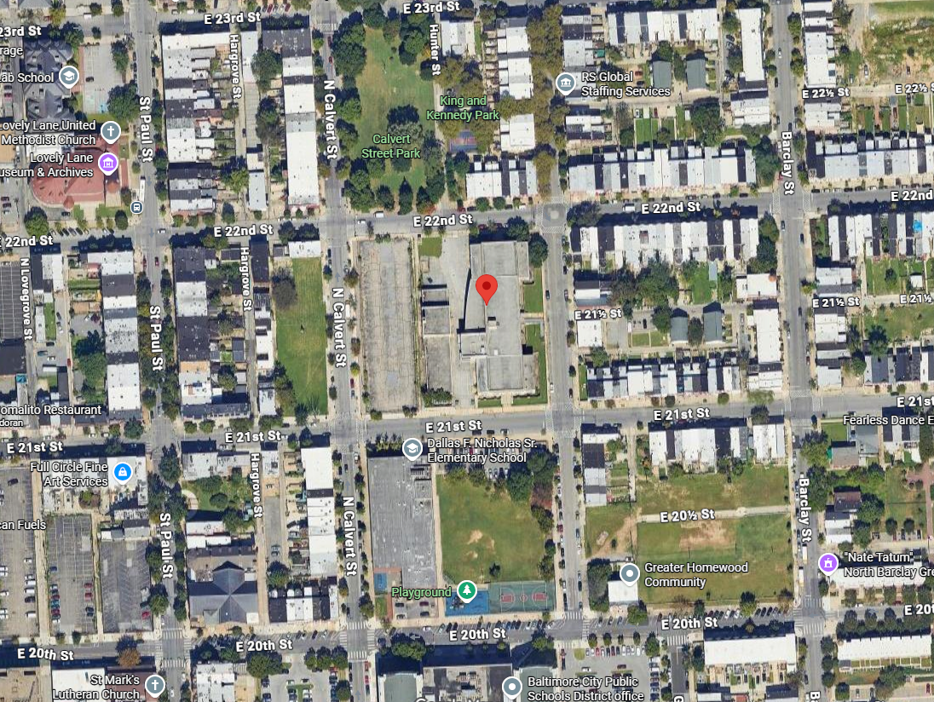
Executive Order re: MD’s Affordable Housing Crisis

Slide 34





Purpose of a Statewide Resilience Strategy
Establish a shared picture of hazards and stressors across the State.
Crosswalk existing plans and programs in the State and develop an understanding of potential gaps.
Align on high-level resilience goals and prioritization criteria for future actions.
Propose and prioritize state-level actions for key sectors – policy, programs, procedures, or otherwise – to increase resilience.
Develop a framework for place-based resilience projects, including cross-agency coordination around that goal.
Notes:
Mike

Slide 35
Sustainable Growth Subcabinet in the Strategy
Convene a funding table in which state agencies pool resources and stack funding to accomplish transformative resilience projects.
Overarching 2.1
Identify focus geographies for agencies to coordinate place-based resilience using existing disaster data, environmental justice data, and other sources.
Overarching 2.2
Develop model ordinances that incorporate resilience to support risk-informed development and land use.
Housing 2.2
Work with local governments to implement the State’s Resilience Planning Principle in comprehensive planning.
Housing 2.3

Slide 36
FEMA Review Council
Hazard Mitigation Plan
Recovery program needs
Undergoing update, expected completion 2026

Slide 37

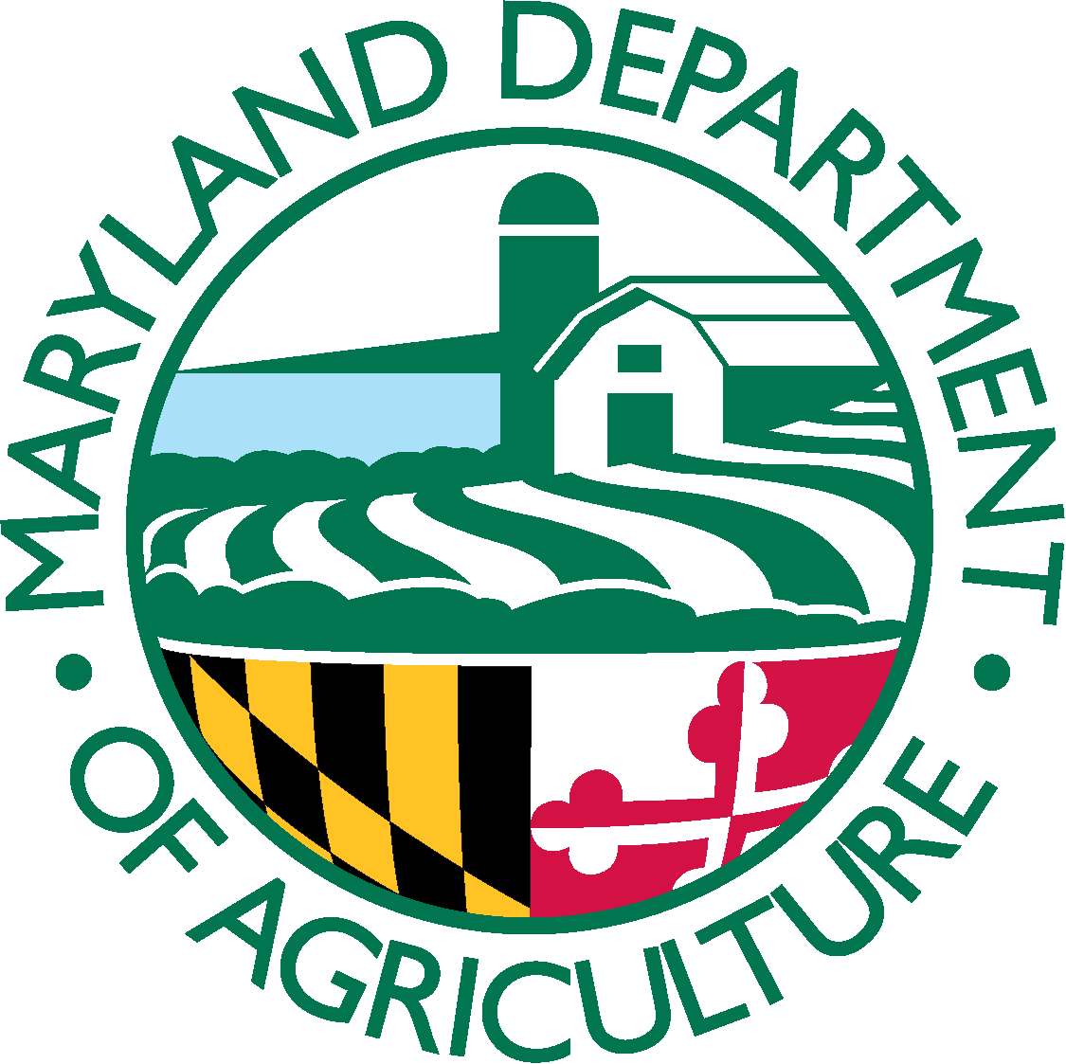

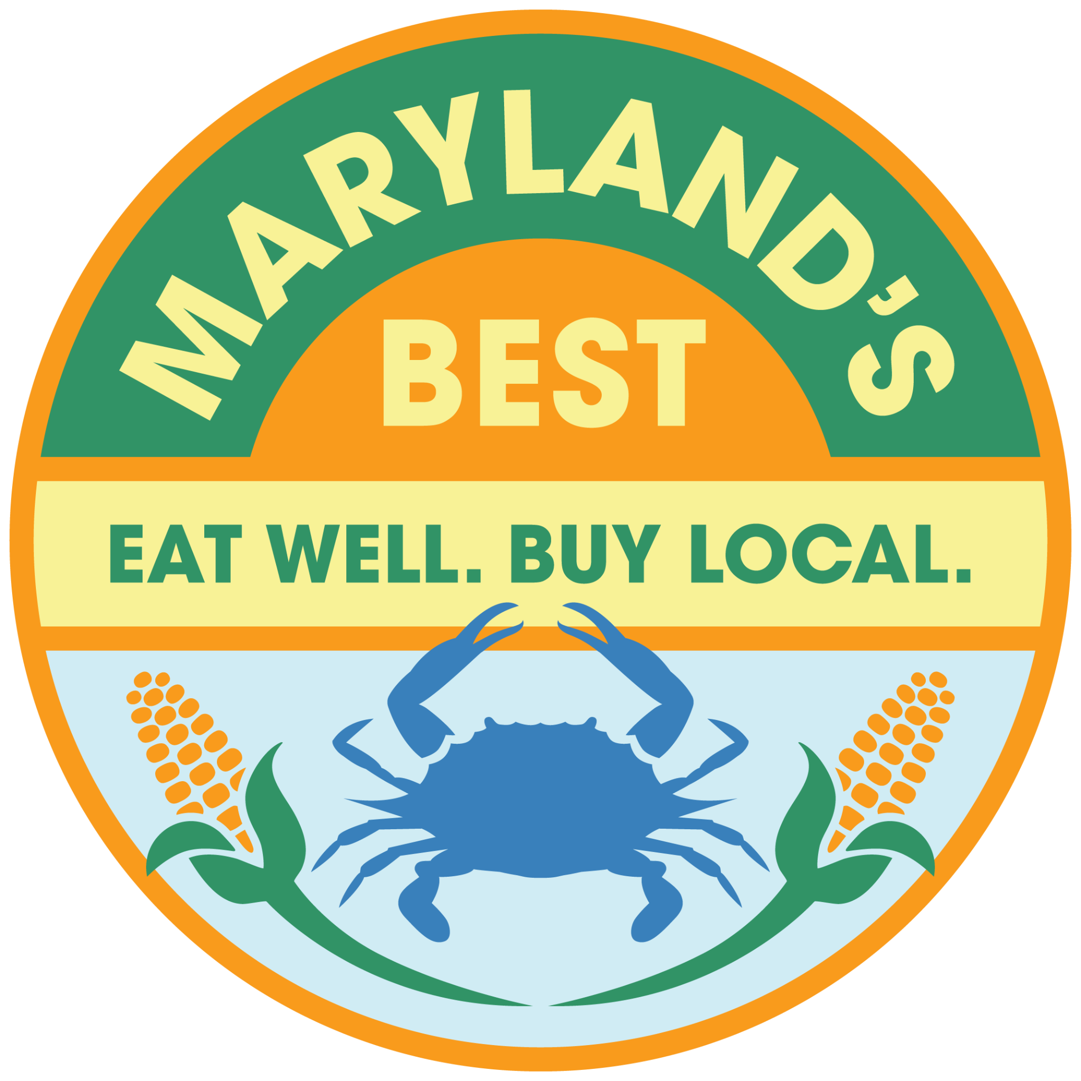
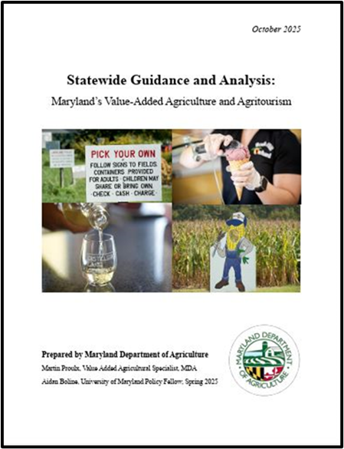
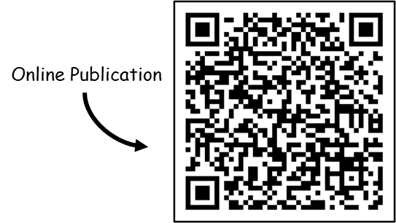
MARKETING AND AGRICULTURAL DEVELOPMENT (MAD)
Added “Business Support” to Marketing (01/2026)
1.) Ag Development
Maryland’s Best
Value-Added Ag Specialist
International
2.) Marketing Initiatives
Consumer Education
Seafood Marketing
3.) Food Access
Certified Local Farm & Fish (CLFF)
Farmers Market Nutrition Program (FMNP)
Maryland Market Money (MMM)
Farm-to-School
Farm and Food Grant Programs
Statewide Guidance and Analysis:
Value-Added Agriculture and Agritourism (11/2025)
A comprehensive overview of Maryland's value-added agriculture and agritourism industries, addressing regulatory complexities, challenges, and opportunities, with a focus on establishing a baseline understanding for policy and decision-making.

Slide 38
Conservation Grants
Maryland Ag Cost-Share: Created by the General Assembly in 1982 to provide grants for the installation of BMPs that control and reduce agriculturally related water pollution
Covers 65% - 87.5% of eligible cost for over 40 conservation practices
Funded by State (Capital) & Federal funding sources | FY 2025:
  $11.5 million in approved projects
  $7.6 million in grants awarded
  723 BMPs implemented
Maryland Cover Crop Program
  Provides grants to help farmers offset seed, labor, and equipment costs associated with planting cover crops
  FY 2025 - Largest Program Enrollment :
    493k acres enrolled
    $32.2 million in grants
    3.4 million lbs nitrogen prevented from reaching the Bay
Notes:
Provides grants to help farmers offset seed, labor, and equipment costs associated with planting cover crops
Various options including rye, barley, wheat, brassicas, legumes & forage radish
Farmers can receive up to $90/acre to plant traditional cover crops on their fields this fall
Annual budget ~$22.5 million split between BRF & CBTF
Most cost effective tool in our conservation toolbox (<$10/lb N reduced)
FY 2025 - Largest Program Enrollment :
493k acres enrolled
$32.2 million in grants
3.4 million lbs nitrogen prevented from reaching the Bay

Slide 39
MDA & Hughes Center Alliance STRATEGIC BLUEPRINT
Partnering for Climate Resiliency
Operationalizing Research & Policy to Protect Maryland Agriculture
Roadmap to Resilience The collaborative framework outlines science and community-driven adaptation priorities. MDA will serve as the lead agency to execute the majority of the report’s recommendations. | Immediate Action & LEEF To deeply integrate cutting-edge agro-ecological science into state policy, a designated representative from the Hughes center will serve on LEEF subcommittees. | ORC Strategic Expansion The Office of Resource Conservation (ORC) is updating its Strategic Plan to build upon water quality, addressing climate vulnerability and delivering risk-management tools to help farmers withstand environmental weather extremes.
Strategic Direction: The Roadmap provides an essential foundation to move the department in the right direction, ensuring Maryland's agricultural sector remains both economically viable and environmentally leading.

Slide 40
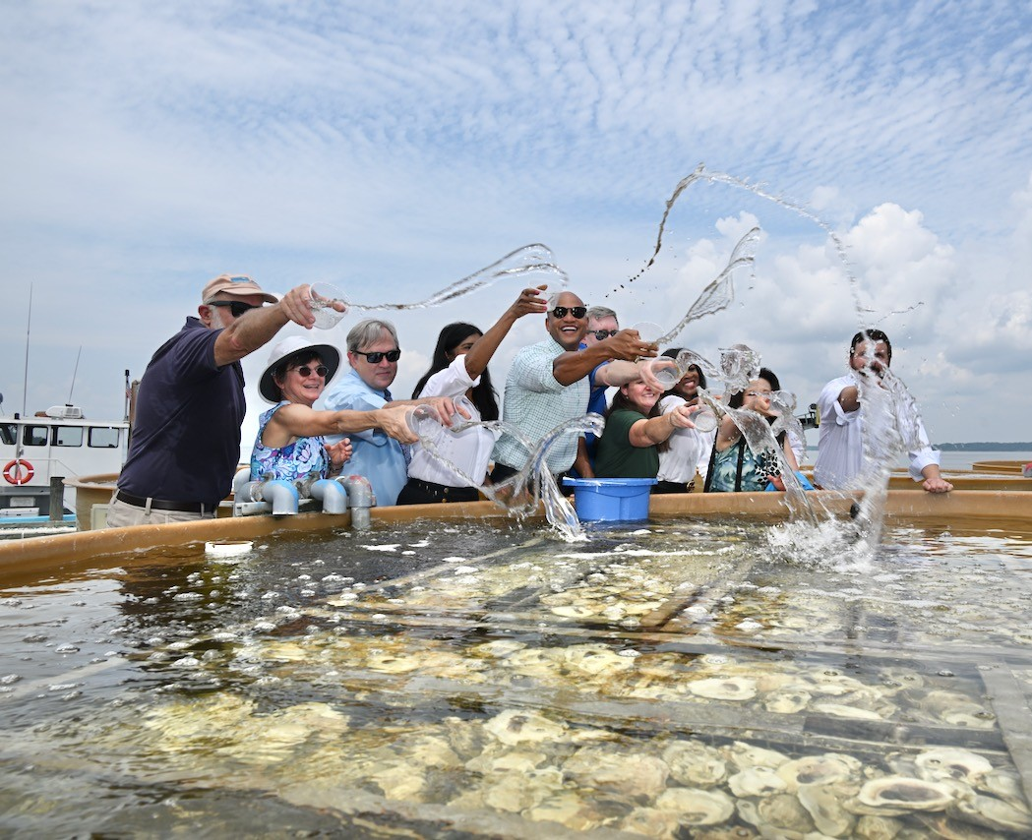

Powering Maryland's Economy
Through Environmental Excellence
Investing in water infrastructure, climate resilience, and energy efficiency — so Maryland communities and businesses thrive.
Secretary Serena McIlwain | Maryland Department of the Environment

Slide 41
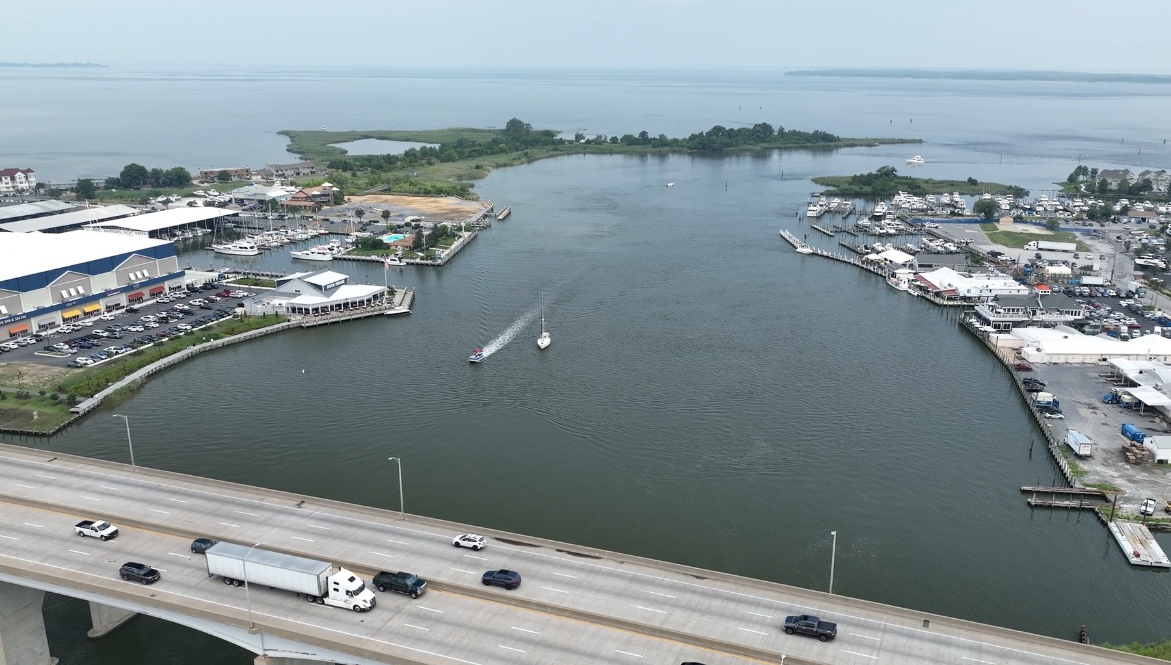
SUSTAINABLE GROWTH
Where Businesses Grow,
Communities Thrive
MDE is part of Secretary Flora's Sustainable Growth Subcabinet — ensuring Maryland grows smartly and sustainably. Strong environmental standards aren't barriers; they make Maryland a place families and businesses choose.
1.8M
Acres preserved through smart growth
$400M+
FY26 budget for Chesapeake Bay
$3.2B
Annual tourism revenue from healthy waterways

Slide 42
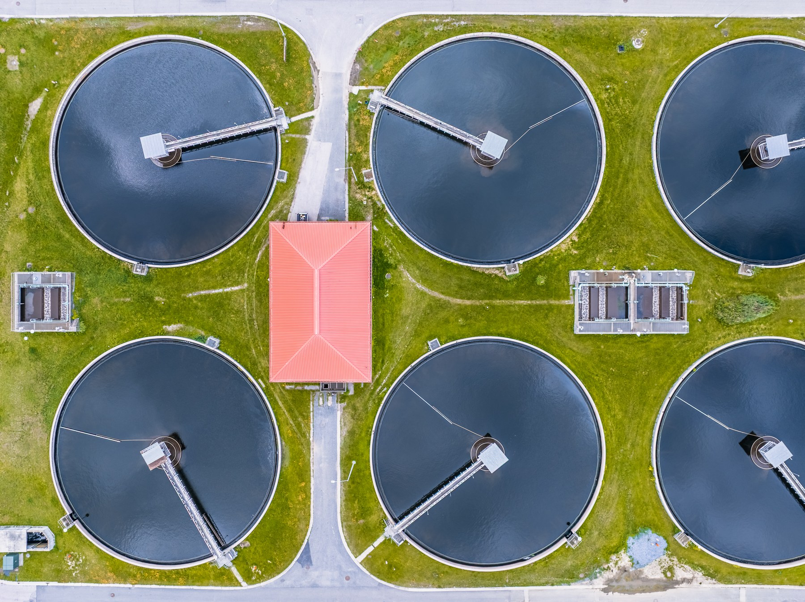
WATER INFRASTRUCTURE INVESTMENT
Hundreds of Millions
Invested in Maryland Communities
MDE's WIFA delivers low-interest loans and grants to build the water and wastewater systems that support every strong community.
~$100M/yr
$246M
Bay Restoration Fund
Water Quality SRF
Upgrades wastewater plants; protects the Bay and its $600M seafood industry
Below-market loans for sewer rehab, nutrient control & stormwater
$76M+
Annual
Drinking Water SRF
Flood Management Grants
Low-interest loans for treatment plants and small community systems
Funds flood mitigation and stream restoration statewide

Slide 43

CLIMATE & BUILDINGS
Helping Building Owners
Cut Energy Costs
Building Energy Performance Standards (BEPS)
Maryland's Climate Solutions Now Act requires buildings over 35,000 sq ft to reach net-zero emissions by 2040, with a 20% interim reduction by 2030.
MDE treats BEPS as a catalyst — not a burden. Heat pumps and electrification cut energy costs while meeting requirements.
35,000 sq ft+
Commercial, multifamily & industrial buildings
2030 Target
20% energy reduction; net-zero by 2040
Heat Pumps
Most cost-effective compliance path
Incentive Alignment
MD Clean Buildings Hub + state/federal financing

Slide 44
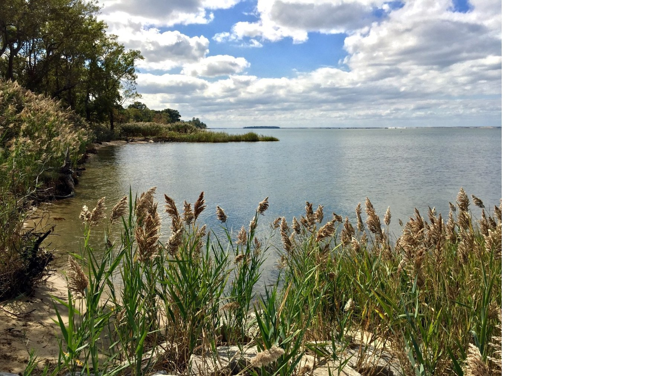
THE MDE COMMITMENT
A Healthy Environment
Is a Strong Economy
01
02
03
Smart Growth Partner
Water Infrastructure Investor
Energy Transition Enabler
Working with the Sustainable Growth Subcabinet to ensure development sustains healthy communities.
Hundreds of millions annually in loans and grants — from Bay restoration to safe drinking water.
BEPS and the Clean Buildings Hub guide owners toward lower costs and lower emissions.
mde.maryland.gov

Slide 45
2026-2030 Maryland State Plan for Higher Education
Statewide plan developed by MHEC to outline priorities & major goals for the State's postsecondary system.
Elements in Plan
  Present and future needs for postsecondary education and research
  Present and future capabilities of our institutions of higher education
  Short and long range objectives & priorities for higher education - including methods and guidelines for achieving objectives and ways to measure progress
Vision for Plan
  Design an affordable, contemporary postsecondary education system that equips every Marylander to thrive in a dynamic economy and a pluralistic democratic republic, ensures the completion of meaningful degrees and credentials for all learners, and drives innovation that strengthens the state’s long-term competitiveness and civic well-being.
Development Process Began in 2025
  Engaged and surveyed partners across the State to assess what should be included in plan
  Partners include institutional executives, faculty, students, researchers, industry & philanthropic leaders, government officials & more
  Draft plan has now been developed
What’s Next
  Final draft to be presented at 6/24/2026 Commission meeting; open to public, starts at 10am
  Upon adoption by Commission, final version will be available on MHC website

Slide 46




2026-2030 State Plan: Statewide Goals
Increase Postsecondary Attainment for Lifelong Success
Drive Post-Completion Success to Advance Social and Economic Mobility
Mobilize Postsecondary Education Innovation and Research for Competitiveness and Public Good
Ensure that more Marylanders earn affordable degrees and credentials that open doors to economic mobility, civic participation, and opportunities for continuous learning throughout life.
Create the conditions for Maryland’s colleges, universities, and career schools to actively drive post-completion success, ensuring that every degree and credential serves as a direct catalyst for upward social and economic mobility.
Integrate Maryland’s postsecondary ecosystem into a unified, whole-of-government strategy to drive discovery and talent development in the state’s lighthouse and priority sectors, while generating cross-agency solutions that enhance civic vitality and solve public challenges.
Leave No Marylander Behind

Slide 47
2026-2030 State Plan for Higher Education
How does State Plan relate to Sustainable Growth and how will it be used?
Goals in Plan Will Address Sustainable Planning Principles of Economy and Equity
  Align workforce and civic needs with instruction provided, which can help ensure all Marylanders have access to living wage jobs
  Allow all Marylanders to have access to higher education that is affordable to them and provides good return on investment
Measuring Success
  Metrics included will be used to monitor progress toward goals
  These might include numeric targets for equity, credentials of value, innovation, and more
Can Help Guide Allocation of Resources
  The Commission’s statutory responsibility to review and recommend operating and capital budgets provides a pathway to align state investments with the priorities outlined in the Plan
  Institutional leaders can develop policies and programs to address goals outlined
  Metrics can be used help leaders assess whether policies and programs are effective
  Funds can be directed toward policies and programs that are aligned with goals or have been proven to be effective, for example:
    Scholarships to assist with affordability and lowering of student debt
    Align academic program offerings with state workforce needs
    Capital projects to address workforce training needs – current projects include new buildings at Howard Community College and Chesapeake College with similar projects being planned elsewhere

Slide 48
Department of Planning​
Modeling Sustainable Futures

Slide 49
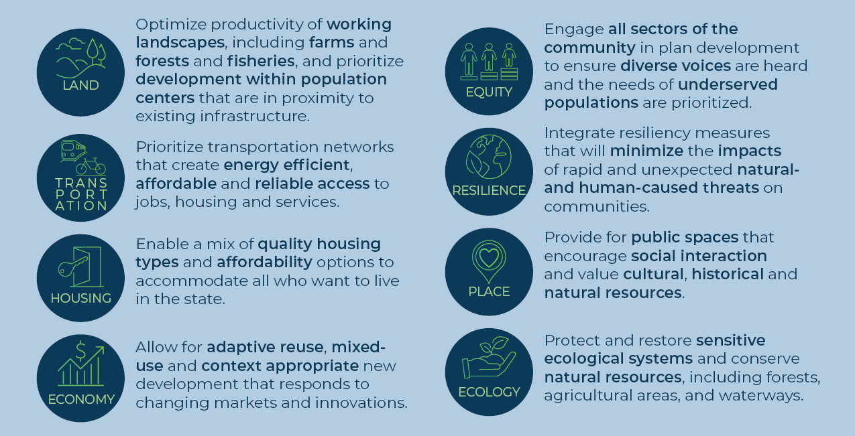
MDP Sustainable Growth Model
Sustainable Growth Planning Principles
Notes:
https://mgaleg.maryland.gov/mgawebsite/Laws/StatuteText?article=gsf&section=5-7A-02&enactments=False&archived=False (Glendenning EO, repealed by Hogan)
Governor shall issue an EO for 578.A.01.c –procedures for
DNR POS conducts consistency review (findings sent to MDP for confirmation – not required)
MDE W&S consistency review (findings sent to MDP for confirmation – not required)
Clearinghouse Project Reviews (certain federal & state funded projects -determined by MDP)

Slide 50
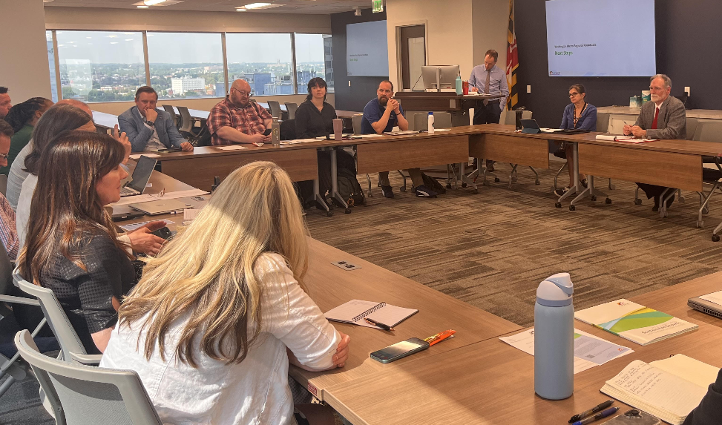
MDP Sustainable Growth Model
Connecting the Sustainable Growth Framework across Agencies and in Communities
Sustainable Growth Model
Published Implementation Guide Dec 2025
Legislative Alignment
Principle Webinars
Supporting Planners
Organized existing Elements under the SG Planning Principles
Improved notification process
Comp Plan Guidance and Checklists
Model Ordinances and Case Examples
Underway: SG Metric Update Cycle
New Fall Roundtables 2026
Washington Metro Regional Roundtable, 2026

Slide 51




Sustainable Growth Model
Supportive Materials
Images linked to guide components

Slide 52
2026 Sustainable Growth Awards
Sustainable Growth Subcabinet Open Forum, June 2026

Slide 53
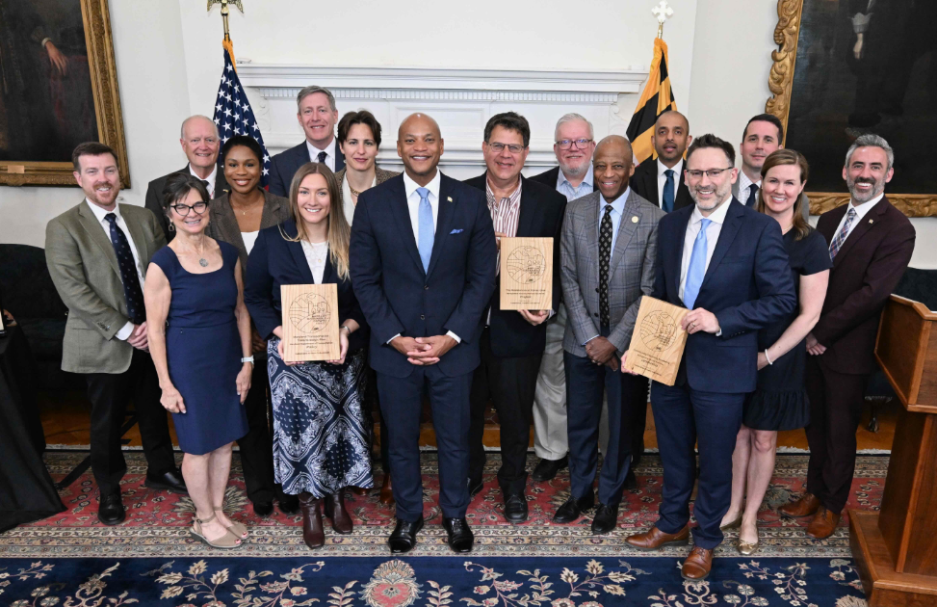
SGSC Sustainable Growth Awards
2026 Season
Showcases the application of best practices in sustainable design and construction of physical buildings, places, infrastructure or landscapes.
Leadership Category
Recognizes individuals and organizations that undertake advocacy, education or other outreach to advance public support for sustainable growth methods.
Project Category
Policy Category
Features the adoption and/or implementation of public policies, regulations and/or plans supporting sustainable land use planning and development practices.
Governor Moore and the Sustainable Growth Subcabinet Members with the 2026 Awardees

Slide 54
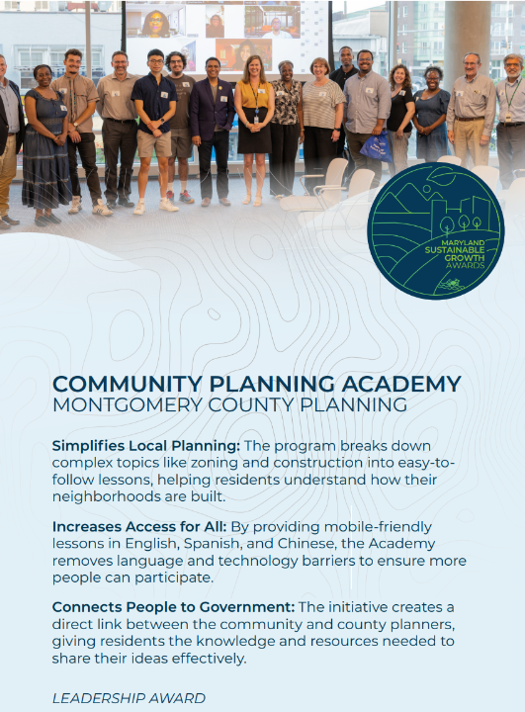
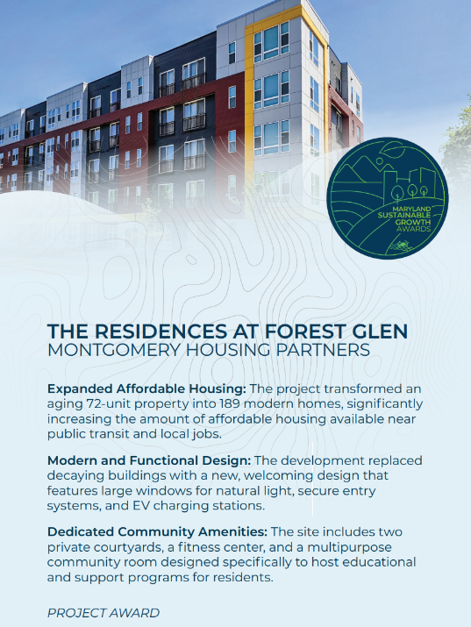
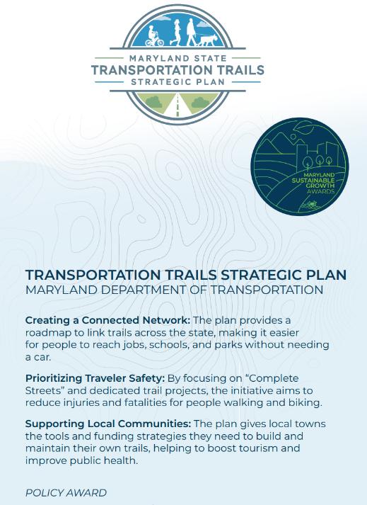
SGSC Sustainable Growth Awards
2026 Award Winners: Leadership – Project – Policy

Slide 55
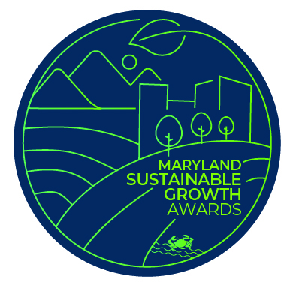
SGSC Sustainable Growth Awards
Call for Nominations
2027 Season
Nomination Window: August 1 – Sept 30, 2026
March Ceremony, Spring 2027
Webpage

Slide 56
Closing Round
Sustainable Growth Subcabinet Open Forum, June 2026

Slide 57
SUSTAINABLE GROWTH SUBCABINET MEMBERS​
MDP Secretary Rebecca Flora, Chair​
DHCD Secretary Jake Day, Vice Chair (Julia Glanz)​
MDA Secretary Kevin Atticks (Michelle Cable)​
DBM Acting Secretary Jake Weissmann (Alison Verba, Christina Perrotti)​
Commerce Secretary Harry Coker (Jim Palma)​
MDEM Secretary Russ Strickland (Mike Hinson) ​
MDE Secretary Serena McIlwain
(Suzanne Dorsey)​
DGS Secretary Atif Chaudhry
(Wendy Scott-Napier) ​
Health Secretary Meena Seshamani (Katie Bhide)​
Higher Education Acting Secretary Elena Quiroz-Livanis
(Shaunda Villones, Dan Schuster)​
Labor Secretary Portia Wu (Ashley Sharp)​
DNR Secretary Josh Kurtz
(Leah Sheppard, Paul Peditto)​
MDOT Secretary Katie Thomson
(Geoff Anderson)​
MEA Director Kelly Speakes-Backman (Jenn Aiosa)​
Assist Sec. of the DHCD Office of Neighborhood
Revitalization: Kari Snyder (Kevin Baynes)​
Governor’s Deputy COS: Chichi Nyagah-Nash
(Meghan Conklin) ​
National Ctr for Smart Growth at UMD:
Dr. Kathryn Howell (ex-officio) (Nick Finio)​
​
(designated alternates) ​

Slide 58
Thank you for joining us today!
Visit the Sustainable Growth Subcabinet Webpage for more information and updates

