Slide 1
PRELIMINARY DRAFT
Confidential for Deliberation Only,
Not Distribution.
Sustainable Growth and Conservation Indicators
Status Check
& Measuring Progress

Slide 2
Agenda
Background, Purpose
Screening criteria
Some important issues
Objectives & Indicators
  Composite indicators
  Individual indicators & measures of progress
Commission discussion, input
Subsequent plans

Slide 3
Background
Commission’s Indicators Work Group
MDP’s indicators work for PlanMaryland Planning Area review process
National Center for Smart Growth’s Opportunity Mapping effort

Slide 4
Purpose
Assess smart growth status & progress: achieve objectives
ID shortcomings, needs, success in programs
Apply Statewide, where possible for regions, individual jurisdictions
Support use by the public, local gov’t, Commission, MDP, & the National Center

Slide 5
Screening Criteria
Only germane objectives
Indicators legitimately measure progress
Likely continued data availability
Within reasonable purview/ responsibilities of PlanMD, Commission, MDP

Slide 6
Important Issues
Adequacy of current suite of objectives & indicators – Work in progress
How will Commission use them?
Measures/ benchmarks appropriate for different regions, jurisdictions, scales
Incomplete, out-of-date or inadequate data
Overly generous or miserly indicators
Mistakes

Slide 7
Sustainable Growth & Conservation Indicators
Draft suite 16 objectives in five categories
Development (3 objectives)
Agricultural and Environmental Resources (3 objectives)
Socio-Economic Equity (2 objectives)
Transportation – Land Use (1 objective)
Economic Development (7 objectives)

Slide 8
Approach for Today
For first Development objective only
  One composite indicator, implications
  All component indicators & measures of progress
All other objectives
  Composite/1 or 2 indicators only
  Component indicators & measures of progress in “Appendix”
Solicit input on objectives, indicators, benchmarks,

Slide 9
Development Objectives:
Accommodate the vast majority of development in Priority Funding Areas (PFAs), and minimize development pressure on resource and environmentally sensitive lands
Accommodate mixed uses in a walkable environment within PFAs
PFAs provide a range of housing types, densities, sizes and values and accommodate socio-economically diverse population

Slide 10
Composite: Accommodate Development in PFAs
Minimize Impacts to Resources & Lands
Composite of 4 equally weighted indicators: % residential parcels, % residential acres, % commercial parcels, and % commercial acres built in PFAs, 1999-2012. 0 = least supportive, 100 = most supportive of Sustainable Growth Objective(s).
Sources: MdProperty View & U.S. Census Bureau

Slide 11
Composite: Accommodate Development in PFAs
Minimize Impacts to Resources & Lands
Implications for Sustainable Growth Objectives:
Statewide, and in every region, growth is being accommodated in PFAs, but not enough to take the pressure off resources and resource lands, contradicting many sustainability objectives. Details vary by region & county.
Statewide, 71% of residential parcels are being developed in PFAs, but 77% of residential acres are being developed outside the PFA, converting 132,675 acres of resource land to development.
Both residential and commercial/ institutional development are factors, but the former’s effect is much greater. Recent multifamily construction may be contributing to improvements in these measures.
Considerably more of future growth must occur in PFAs to support sustainable growth and conservation objectives.
Sources: MdProperty View & U.S. Census Bureau

Slide 12
Residential Development, 1999-2012
Parcels and Acres In and Outside PFAs*
Maryland by Region
72,202 Parcels
85,421 Parcels
17,874 Parcels
15,601 Parcels
27,880 Parcels
12,234 Parcels
231,212 Parcels
72,202 Parcels*
85,421 Parcels*
17,874 Parcels*
15,601 Parcels*
27,880 Parcels*
12,234 Parcels*
231,212 Parcels*
33,820 Acres
53,997 Acres
19,755 Acres
14,007 Acres
33,325 Acres
16,946 Acres
171,850 Acres
*Includes single family (detached, duplexes, townhouses, and condos) but not apartments/multifamily units.
Source: MdProperty View

Slide 13
Residential Development, 1999-2012
Parcels and Acres In and Outside PFAs*
Maryland by Region
Implications for Sustainable Growth Objectives:
Statewide, 71% of residential parcels are being developed in PFAs, but 77% of residential acres are being developed outside the PFA, converting 132,675 acres of resource land to development. Even when 80% (Capital Region) or more of growth is concentrated in PFAs, market pressure continues to compromise substantial resource & environmentally sensitive lands.
72,202 Parcels
85,421 Parcels
17,874 Parcels
15,601 Parcels
27,880 Parcels
12,234 Parcels
231,212 Parcels
72,202 Parcels*
85,421 Parcels*
17,874 Parcels*
15,601 Parcels*
27,880 Parcels*
12,234 Parcels*
231,212 Parcels*
33,820 Acres
53,997 Acres
19,755 Acres
14,007 Acres
33,325 Acres
16,946 Acres
171,850 Acres
*Includes single family (detached, duplexes, townhouses, and condos) but not apartments/multifamily units.
Source: MdProperty View

Slide 14
Baltimore & Capital Regions
Residential Development, 1999-2012
Parcels In & Acres Outside PFAs*
23,001 Parcels
3,459 Parcels
19,229 Parcels
8,947 Parcels
15,017 Parcels
15,768 Parcels
16,368 Parcels
25,131 Parcels
30,703 Parcels
11,060 Acres
212 Acres
12,288 Acres
10,259 Acres
11,600 Acres
8,578 Acres
10,393 Acres
10,899 Acres
12,529 Acres
*Includes single family (detached, duplexes, townhouses, and condos) but not apartments/multifamily units.
Source: MdProperty View

Slide 15
Baltimore & Capital Regions
Residential Development, 1999-2012
Parcels In & Acres Outside PFAs*
Implications for Sustainable Growth Objectives
Counties in these two most populated regions in the state had the lowest percents of land developed outside of PFAs. But the acres of resource land lost are, nonetheless, the greatest. Individual county percents range from a low of 51% in Prince George’s County to 81% in Carroll County.
23,001 Parcels
3,459 Parcels
19,229 Parcels
8,947 Parcels
15,017 Parcels
15,768 Parcels
16,368 Parcels
25,131 Parcels
30,703 Parcels
11,060 Acres
212 Acres
12,288 Acres
10,259 Acres
11,600 Acres
8,578 Acres
10,393 Acres
10,899 Acres
12,529 Acres
*Includes single family (detached, duplexes, townhouses, and condos) but not apartments/multifamily units.
Source: MdProperty View

Slide 16
Residential Development, 1999-2012
Parcels In & Acres Outside PFAs*
Western & Southern Maryland Regions
1,264 Parcels
2,942 Parcels
8,028 Parcels
7,000 Parcels
11,931 Parcels
8,949 Parcels
2,680 Acres
6,295 Acres
7,971 Acres
7,778 Acres
12,590 Acres
12,957 Acres
*Includes single family (detached, duplexes, townhouses, and condos) but not apartments/multifamily units.
Source: MdProperty View

Slide 17
Residential Development, 1999-2012
Parcels In & Acres Outside PFAs*
Western & Southern Regions
Implications for Sustainable Growth Objectives
Counties in the Western and Southern Regions have notably lower percents of parcels built in PFAs and correspondingly higher percents residential acres developed outside of PFA than counties in the Metro regions. However, populations are smaller & so too are absolute acreage losses.
1,264 Parcels
2,942 Parcels
8,028 Parcels
7,000 Parcels
11,931 Parcels
8,949 Parcels
2,680 Acres
6,295 Acres
7,971 Acres
7,778 Acres
12,590 Acres
12,957 Acres
*Includes single family (detached, duplexes, townhouses, and condos) but not apartments/multifamily units.
Source: MdProperty View

Slide 18
Residential Development, 1999-2012
Parcels In & Acres Outside PFAs*
Eastern Shore Regions
2,011 Parcels
6,925 Parcels
1,476 Parcels
3,993 Parcels
3,469 Parcels
2,208 Parcels
3,381 Acres
1,255 Parcels
6,540 Parcels
231,212 Parcels
3,381 Acres
7,088 Acres
1,691 Acres
3,540 Acres
4,054 Acres
2,970 Acres
2,260 Acres
4,744 Acres
4,034 Acres
171,850 Acres
*Includes single family (detached, duplexes, townhouses, and condos) but not apartments/multifamily units.
Source: MdProperty View

Slide 19
Residential Development, 1999-2012
Parcels In & Acres Outside PFAs*
Eastern Shore Regions
Implications for Sustainable Growth Objectives
Like the Western and Southern Regions, the Eastern Shore Regions have generally lower percents of parcels developed in the PFAs and higher percents of acres developed outside the PFAs. Also as in those Regions, populations are smaller & so too are the absolute acreage losses.
2,011 Parcels
6,925 Parcels
1,476 Parcels
3,993 Parcels
3,469 Parcels
2,208 Parcels
3,381 Acres
1,255 Parcels
6,540 Parcels
231,212 Parcels
3,381 Acres
7,088 Acres
1,691 Acres
3,540 Acres
4,054 Acres
2,970 Acres
2,260 Acres
4,744 Acres
4,034 Acres
171,850 Acres
*Includes single family (detached, duplexes, townhouses, and condos) but not apartments/multifamily units.
Source: MdProperty View

Slide 20
Comparison: Percent of Residential Parcels versus Total Units* Built Inside PFAs, 2007-2012
*Includes both single family (detached, duplexes, townhomes and condos) and apartments/multifamily units.
Source: Md PropertyView and U.S. Census Bureau

Slide 21
Comparison of Percent of Residential Parcels versus Total Units* Built Inside PFAs, 2007-2012
Implications for Sustainable Growth Objectives:
Generally, the percent of all units developed in PFAs exceeds the percent of single family units by about 5 to 10 percent per region. Most apartment/multifamily units are built inside PFAs. Their effect on percentages of acres developed in versus outside PFAs, if it could be calculated, is probably very small, on the order of a few percentage points. It does not substantially affect the implications of development in and outside PFAs, but probably does reflect higher proportion of multifamily units developed recently in some areas.
*Includes both single family (detached, duplexes, townhomes and condos) and apartments/multifamily units.
Source: Md PropertyView and U.S. Census Bureau

Slide 22
Measuring Progress, 1999-2012
Percent Total Residential Units Built in PFAs*
*Includes both single family (detached, duplexes, townhomes and condos) and apartments/multifamily units.
Source: MdProperty View & U.S. Census Bureau

Slide 23
Measuring Progress, 1999-2012
Percent Residential Units Built in PFAs*
Implications for Sustainable Growth Objectives:
Percent of total new units in (versus out of) PFAs statewide has fluctuated around 80% since 1999. The last 8 years, largely coincident with the economic downturn, suggests possible improvements, particularly in the metro regions, where multifamily construction has increased as a percent of total units.
*Includes both single family (detached, duplexes, townhomes and condos) and apartments/multifamily units.
Source: MdProperty View & U.S. Census Bureau

Slide 24
Commercial/Institutional Development, 2001-2012
Parcels & Acres Developed Inside/Outside PFAs
446 Parcels
685 Parcels
2,244 Parcels
735 Parcels
571 Parcels
1,558 Parcels
6,239 Parcels
5,389 Acres
3,226 Acres
228,066 Acres
2,670 Acres
83,992 Acres
1,836,573 Acres
2,159,917 Acres
Source: MdProperty View

Slide 25
Commercial/Institutional Development, 2001-2012
Parcels & Acres Developed Inside/Outside PFAs
Implications for Sustainable Growth Objectives
Generally, the inverse relation between % developed parcels in and % developed acres outside PFAs is similar to but much less pronounced than for residential development. It is completely absent in Baltimore, Upper Eastern Shore, and Capital Regions. More commercial and institutional establishments away from communities in PFAs means more land consumed and natural resources impacted; more infrastructure costs; and more driving and GHG (greenhouse gas) emissions to move between home, jobs, and other regular destinations.
446 Parcels
685 Parcels
2,244 Parcels
735 Parcels
571 Parcels
1,558 Parcels
6,239 Parcels
5,389 Acres
3,226 Acres
228,066 Acres
2,670 Acres
83,992 Acres
1,836,573 Acres
2,159,917 Acres
Source: MdProperty View

Slide 26
Development Objectives:
Accommodate the vast majority of development in Priority Funding Areas (PFAs), and minimize development pressure on resource and environmentally sensitive lands
Accommodate mixed uses in a walkable environment within PFAs
PFAs provide a range of housing types, densities, sizes and values and accommodate socio-economically diverse population

Slide 27
Composite: Mixed Use - Walkable Environment in PFAs
Composite of 4 equally weighted indicators: proximity of residential parcels to transit, recreation, and commercial establishments, & access to jobs by walk/transit.
0 = least supportive, 100 = most supportive of Sustainable Growth Objective(s).
Maximum Total Score=40
*Note: data on local transit services is being updated, ETA 12/14. Updates will likely improve proximity of residences to transit measures & decrease the job access metric in some areas.
Source: MdProperty View , Maryland Department of Planning

Slide 28
Composite: Mixed Use - Walkable Environment in PFAs
Implications for Sustainable Growth Objectives:
Walkable environments provide walk access to most daily destinations along local roads, trails, or via transit. Important destinations include commercial and retail establishments, recreation facilities, jobs, and many others.
Overall, each of the regions has one or more shortcomings as measured in mixed use - walkability. Related land use and travel patterns underlie the need to leave one’s community generally by car to reach many or most regular destinations.
Measures of recent progress do not indicate any widespread improvement, which may be occurring in discrete locations.
Note: proximity to commercial for this metric is too “generous” and does not adequately measure progress toward the objective. We are exploring ways to improve it.
Maximum Total Score=40
Source: MdProperty View, Maryland Department of Planning

Slide 29
Development Objectives:
Accommodate the vast majority of development in Priority Funding Areas (PFAs), and minimize development pressure on resource and environmentally sensitive lands
Accommodate mixed uses in a walkable environment within PFAs
Accommodate socio-economically diverse population: PFAs provide a mix of housing types and affordable costs of living

Slide 30
Composite: Accommodate Socio-economically Diverse Population
Composite of 6 equally weighted indicators: housing diversity, housing affordability & affordability of combined housing/transportation costs (both for single & 2 income HH’s), rent affordability. 0 = least supportive, 100 = most supportive of Sustainable Growth Objective(s).
Maximum Total Score=40
Sources: Center for Neighborhood Technology, HUD AMI (2007-2011). 2008 – 2012 American Community Survey. MdProperty View housing sales data, Maryland Department of Education

Slide 31
Accommodate Socio-economically Diverse Population
Implications for Sustainable Growth Objectives:
Combining metrics for housing, costs, & ability to accommodate diverse population suggests that many elements of this indicator must be addressed throughout the State.
Shortcomings vary among regions and income groups. Needs vary from more alternatives to single-family detached housing, and better balance between costs of housing, rental and transportation costs and the incomes of single professionals and two income households.
Recent measures of progress not yet available, to be determined.
Shortcomings and solutions must be examined & sought by region and jurisdiction.
Maximum Total Score=40
Sources: Center for Neighborhood Technology, HUD AMI (2007-2011). 2008 – 2012 American Community Survey. MdProperty View housing sales data, Maryland Department of Education

Slide 32
Agricultural & Environmental Resource Objectives

Slide 33
Agricultural & Environmental Resource Objectives
  Outside PFAs/ inside target conservation areas, residential fragmentation of resource lands & vulnerability to and threat from additional subdivision and development are minimized by local land use plans, zoning and other tools.
  Land use stability is maximized in these areas, providing time to achieve conservation goals before resources are excessively compromised by development
  The preceding objectives are maximized in Priority Preservation Areas, Rural Legacy Areas, and other PlanMaryland Natural and Water Resource areas
Notes:
Follow this slide with maps and regional graphs for fragmentation, vulnerability and threat.
Add one graph by county for fragmentation, and another for stability.
Add a footnote to, or add to the footnote on, the vulnerability slides and stability slides that says “Implementation of Septic Growth Tier IV areas in Garrett, Somerset, Harford, and possibly Prince George’s counties may significantly reduce vulnerability and increase stability of rural lands from that shown.”

Slide 34
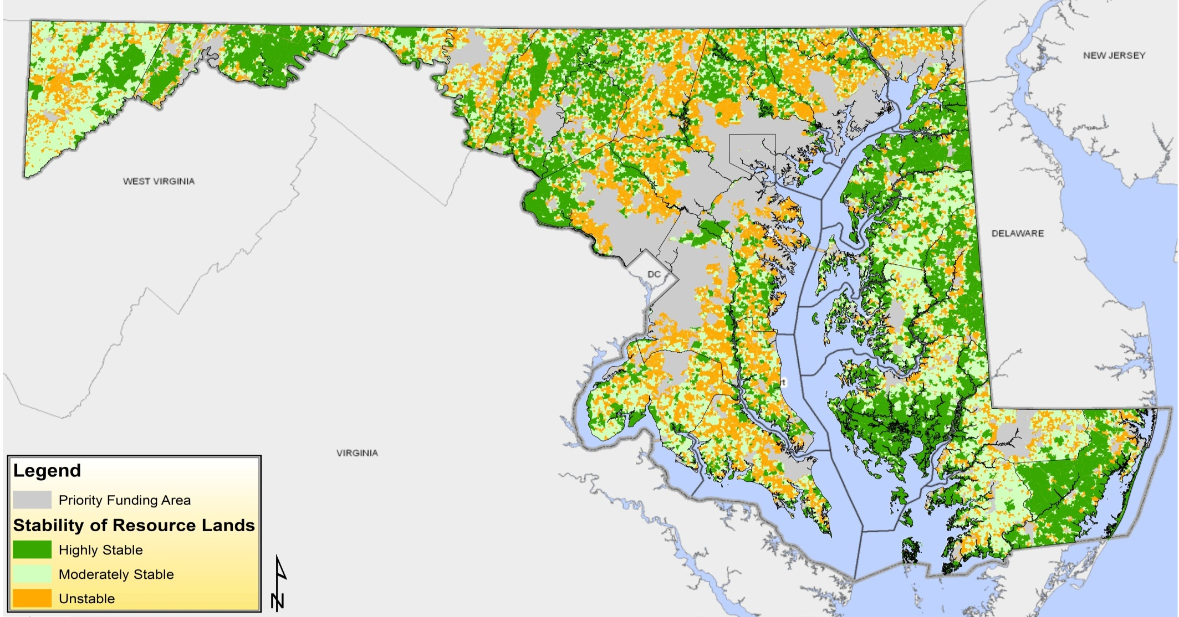
Overall Stability* of Resource Lands, 2012
*Fragmentation, Vulnerability and Threat are considered together to estimate land use stability through zoning, preservation and land use tools, in light of development threat and conservation goals. Implementation of Septic Growth Tier IV areas in Garrett, Somerset, Harford, and possibly Prince George’s counties may significantly reduce vulnerability and increase stability of rural lands from what is shown
Source: MdProperty View, Maryland Department of Planning

Slide 35
Overall Stability of Resource Lands, 2012
*Fragmentation, Vulnerability and Threat are considered together to estimate land use stability through zoning, preservation and land use tools, in light of development threat and conservation goals. Implementation of Septic Growth Tier IV areas in Garrett, Somerset, Harford, and possibly Prince George’s counties may significantly reduce vulnerability and increase stability of rural lands from what is shown
Source: MdProperty View, Maryland Department of Planning

Slide 36
Overall Stability of Resource Lands*, 2012
*Fragmentation, Vulnerability and Threat are considered together to estimate land use stability through zoning, preservation and land use tools, in light of development threat and conservation goals. Implementation of Septic Growth Tier IV areas in Garrett, Somerset, Harford, and possibly Prince George’s counties may significantly reduce vulnerability and increase stability of rural lands from what is shown
Source: MdProperty View, Maryland Department of Planning

Slide 37
Overall Stability of Resource Lands, 2012
Implications for Sustainable Growth Objectives:
Statewide, public return on conservation investment is not well supported by land use tools on between 30 and 60% of the land outside PFAs.
By region, as little as 19% and as much as 50% is highly stable assuming market pressures don’t change, providing time for easement & land acquisition to achieve state & local goals before the land resource is excessively compromised.
By county, % highly stable land ranges from 14 to 74%.
Past development, vulnerability and recent market threat all contribute to this measure.
Septic Growth Tier implementation may improve these measures in some counties.
*Fragmentation, Vulnerability and Threat are considered together to estimate land use stability through zoning, preservation and land use tools, in light of development threat and conservation goals. Implementation of Septic Growth Tier IV areas in Garrett, Somerset, Harford, and possibly Prince George’s counties may significantly reduce vulnerability and increase stability of rural lands from what is shown
Source: MdProperty View, Maryland Department of Planning

Slide 38
Socio-Economic Equity Objectives

Slide 39
Socio-Economic Equity Objectives
Lower income households have access to
  Affordable housing
  Affordable combined housing and transportation costs
  Jobs commensurate with education & training
Populations of poverty and high risk are not geographically concentrated and isolated

Slide 40
Composite: Lower income households Have access to Affordable housing, Housing + Transportation, & Rent*
Composite of 3 indicators, each weighted equally: affordable housing, affordable combined housing + transportation costs, & affordable rent. 0 = least supportive, 100 = most supportive of Sustainable Growth Objective(s).
Maximum Total Score=40
*Household income = 50% of HUD’s Area Median Income (AMI), 2007-2011. Standard for affordable H+T Cost is 45% of income. Estimated H+T Cost from Center for Neighborhood Technology. Rent rates from ACS 2008-2012. Home sales from MPV 2007-2012.
Data source: American Community Survey 2008-2012 and 2011 LEHD
Notes:
This needs to be revised.

Slide 41
Composite: Lower income households Have access to Affordable housing, Housing + Transportation, & Rent*
Implications for Sustainable Growth Objectives:
Access to affordable housing, transportation and rent is fundamental to quality of life for low income population. All are in short supply statewide and in every region.
Maximum Total Score=40
Data source: American Community Survey 2008-2012 and 2011 LEHD

Slide 42
Socio-Economic Equity Objectives
Lower income households have access to
  Affordable housing
  Affordable combined housing and transportation costs
  Jobs commensurate with education & training
Populations of poverty and high risk are not geographically concentrated and isolated

Slide 43
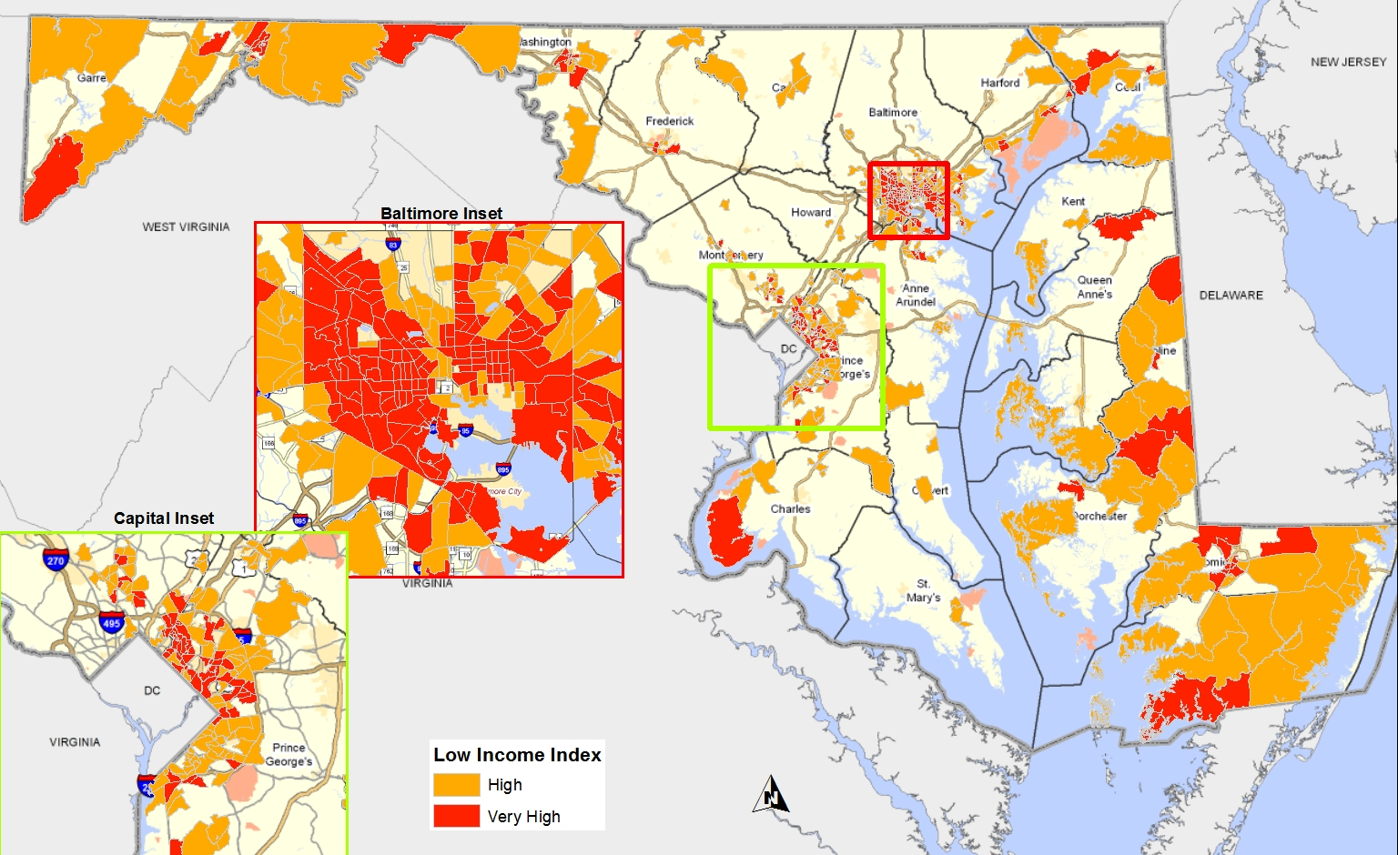
Concentrations of Vulnerable Population, 2012
Source: 2007 – 2012 American Community Survey
Notes:
Implications for Sustainable Growth Objectives: There are clear concentrations of vulnerable, relatively isolated populations in the metro regions and in parts of Southern Maryland, Western Maryland and the Eastern Shore.

Slide 44
Concentrations of Vulnerable Population, 2012
Implications for Sustainable Growth Objectives:
There are clear concentrations of vulnerable, relatively isolated populations in the metro regions and in parts of Southern Maryland, Western Maryland and the Eastern Shore.
Source: 2007 – 2012 American Community Survey
Notes:
Implications for Sustainable Growth Objectives: There are clear concentrations of vulnerable, relatively isolated populations in the metro regions and in parts of Southern Maryland, Western Maryland and the Eastern Shore.

Slide 45
Sustainable Transportation - Land Use Objectives

Slide 46
Transportation – Land Use Objectives
Transportation, growth and redevelopment are planned and implemented in concert to
  Enhance connectivity within and between PFAs
  Increase multimodal travel
  Reduce travel times, vehicle miles traveled, and greenhouse gas emissions from mobile sources

Slide 47
Composite: Transportation – Land Use Objective
Composite of 6 individual indicators: transit-based job accessibility, % population & employment near rail stations, VMT per capita and resident, % PFA jobs held by residents, commute trips by mode. Each is weighted equally. 0 = least supportive, 100 = most supportive of Sustainable Growth Objective(s).
Source: LEHD data, U.S. Census Bureau, LEHD Origin-Destination Employment Statistics 2010, 2007-2011 American Community Survey
Notes:
This needs to be checked and recalulated?! Its missing MVT!

Slide 48
Transportation – Land Use
Implications for Sustainable Growth Objectives:
There are serious shortcomings in the relationship between transportation and land use throughout the State.
The root of it is our segregated land use patterns, in which origins and destinations are often far apart and difficult or impossible to connect without driving. A lack of transit in some regions, relatively few living near transit where it exists, and the difficulty in changing decades-long practices all contribute to the problem.
Transportation alone cannot solve the problem; it requires integrated transportation/ land use reform, i.e., a fundamental rethinking of the relations between development, population origins & destinations, the transportation connections between them, and how these things combine to support community.
Source: LEHD data, U.S. Census Bureau, LEHD Origin-Destination Employment Statistics 2010, 2007-2011 American Community Survey

Slide 49
Economic Development Objectives

Slide 50
Economic Development Objectives
The value of residential, commercial, and industrial real estate in PFAs is stable or increasing
The number of jobs in PFAs is stable or increasing
Household income is commensurate with costs of living
A diverse, educated, skilled workforce is available for current and potential employers
Physical assets (infrastructure) in PFAs have potential to support new business and employers
The business environment for agricultural, forestry and other resource based industries is stable or improving
Land use outside PFAs and within designated resource conservation areas is stable and supports resource based and compatible.

Slide 51
Average Assessed Value of Real Estate Properties, 2001- 2011*
* Residential average data axis is on the right, commercial and industrial axis is on the left. All comparative data to planning areas is inside PFAs unless otherwise noted.
Source: MdPropertyView

Slide 52
Aggregate Improvement to Land Value Ratios by Region
2012 Values of Improved Commercial Parcels During 3 Periods of Time*
*Ratio is the sum of assessed 2012 improvement values divided by the sum of land values for all assessed commercial and institutional parcels.
Source: MdProperty View
Notes:
This is cumulative.

Slide 53
Median Improvement to Land Value Ratios by Region
2012 Values of Commercial Parcels Improved During 3 Periods of Time *
*Ratio is the median of all parcels’ individual ratios of 2012 assessed improvement value divided by land value.
Source: MdProperty View
Notes:
This is the MEDIAN values.

Slide 54
The value of residential, commercial, and industrial real estate in PFAs is stable or increasing
Implications for Sustainable Growth Objectives:
Average values of residential properties have slowly risen slowly over time, while those of commercial and industrial property values have been more erratic, some of which may be due to three year assessment cycles.
Improvement to land value ratios for commercial properties in all regions are increasingly higher for more recently improved properties, both in aggregate and as measured by median ratios of individual properties.
Together, the data suggest that the value of developed properties in PFAs is generally stable or increasing, and that development remains somewhat attractive to markets.
We are currently calculating improvement/ land value ratios over time based on year-specific assessed values, adjusted for inflation. This may indicate if developed properties are being increasingly used for their economic development potential over time.

Slide 55
Economic Development Objectives
The value of residential, commercial, and industrial real estate in PFAs is stable or increasing
The number of jobs in PFAs is stable or increasing
Household income is commensurate with costs of living
A diverse, educated, skilled workforce is available for current and potential employers
Physical assets (infrastructure) in PFAs have potential to support new business and employers
The business environment for agricultural, forestry and other resource based industries is stable or improving
Land use outside PFAs and within designated resource conservation areas is stable and supports resource based and compatible.

Slide 56
Percent Change in Number of Jobs in PFAs
2010-2011
Source: LEHD Origin-Destination Employment Statistics 2011.

Slide 57
Percent Change in Number of Jobs in PFAs
2010-2011
Implications for Sustainable Growth Objectives:
The number of jobs in PFAs increased slightly (Western MD) to modestly (Southern MD) from 2010 to 2011.
Comparable data is not available before 2010. 2012 data will be available shortly.
Source: LEHD Origin-Destination Employment Statistics 2011.

Slide 58
Economic Development Objectives
The value of residential, commercial, and industrial real estate in PFAs is stable or increasing
The number of jobs in PFAs is stable or increasing
Household income is commensurate with costs of living
A diverse, educated, skilled workforce is available for current and potential employers
Physical assets (infrastructure) in PFAs have potential to support new business and employers
The business environment for agricultural, forestry and other resource based industries is stable or improving
Land use outside PFAs and within designated resource conservation areas is stable and supports resource based and compatible.

Slide 59
Housing + Transportation Costs in PFAs,
Cost Above Affordability Standard for Single Professionals*
*Household income = Median Teacher’s Salary (2011) for each region. Standard for affordability H+T Cost is 45% of income. Estimated H+T Cost from Center for Neighborhood Technology. Percent shows by how much estimated costs exceeds the standard for affordability.
Source: Maryland Department of Education, Maryland Department of Planning

Slide 60
Housing + Transportation Costs in PFAs,
Cost Above Affordability Standard for Two Income Households*
*Household income = 80% of HUD’s Area Median Income (AMI), 2007-2011. Standard for affordable H+T Cost is 45% of income. Estimated H+T Cost from Center for Neighborhood Technology. Percent show by how much estimated costs exceeds the standard for affordability.

Slide 61
Household income is commensurate with costs of living – Affordability of Housing & Transportation Cost
Implications for Sustainable Growth Objectives:
For both single professionals and two-income households, combined costs exceed affordability in all regions, quite substantially in some.

Slide 62
Economic Development Objectives
The value of residential, commercial, and industrial real estate in PFAs is stable or increasing
The number of jobs in PFAs is stable or increasing
Household income is commensurate with costs of living
A diverse, educated, skilled workforce is available for current and potential employers
Physical assets (infrastructure) in PFAs have potential to support new business and employers
The business environment for agricultural, forestry and other resource based industries is stable or improving
Land use outside PFAs and within designated resource conservation areas is stable and supports resource based and compatible.

Slide 63
Job/ Workforce Balance For PFA Residents, By Region*
*Average ratios of % low, medium, and high skill workers resident in PFAs to % of skill-appropriate jobs accessible via 30 minute auto & 45 minute transit commutes. Value of 1.0 is balance between populations and jobs, higher means imbalance.
Source: 2008 – 2012 American Community Survey, LEHD Origin-Destination Employment Statistics 2010.

Slide 64
Job/ Workforce Balance For PFA Residents, By Region*
Implications for Sustainable Growth Objectives:
There is considerable imbalance between workforce populations and transportation-accessible, skill-appropriate jobs statewide and in all regions. The greatest imbalance is outside the metro areas, but it is considerable within those areas also.
*Average ratios of % low, medium, and high skill workers resident in PFAs to % of skill-appropriate jobs accessible via 30 minute auto & 45 minute transit commutes. Value of 1.0 is balance between populations and jobs, higher means imbalance.
Source: 2008 – 2012 American Community Survey, LEHD Origin-Destination Employment Statistics 2010.

Slide 65
Economic Development Objectives
The value of residential, commercial, and industrial real estate in PFAs is stable or increasing
The number of jobs in PFAs is stable or increasing
Household income is commensurate with costs of living
A diverse, educated, skilled workforce is available for current and potential employers
Physical assets (infrastructure) in PFAs have potential to support new business and employers
The business environment for agricultural, forestry and other resource based industries is stable or improving
Land use outside PFAs and within designated resource conservation areas is stable and supports resource based and compatible.

Slide 66
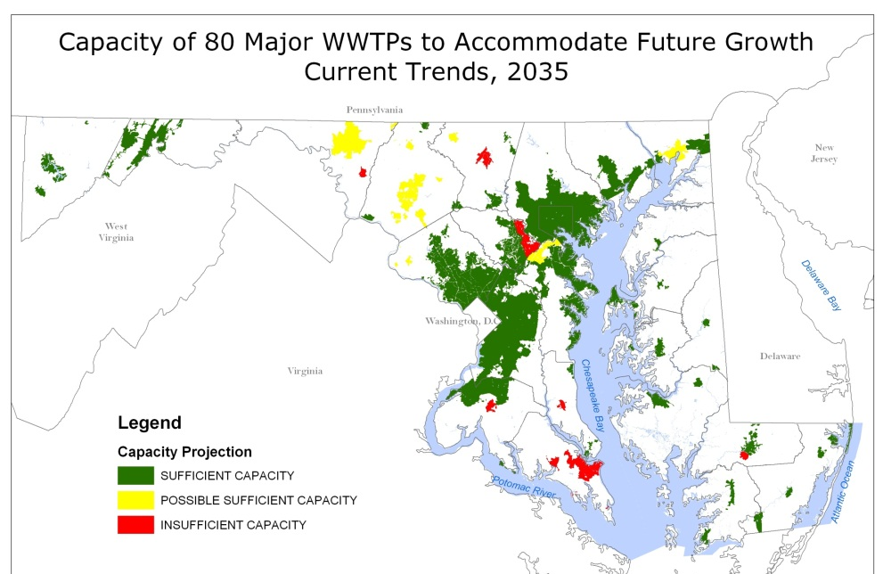
Waste Water Treatment Plant Capacity

Slide 67
Transit-Based Job Accessibility from PFAs in 45 minutes (as % of jobs accessible by auto alone)*
*Source: Analysis by SMZ (state modeling zone) aggregated by PFA, county, & region. Data not yet available outside metro regions.
Source: Maryland State Transportation Model

Slide 68
Consolidated Transportation Plan Funding*
*SHA, MTA, MAA, MPA, MVA, and MDTA’s major projects are classified per the CTP’s statewide project-funding summary. Multijurisdictional projects are SHA and MDTA projects that cross multiple jurisdictions. They are shown separately, but are also reflected in regional figures based on the proportion of the project in the region.
Source: Maryland FY 2013-2018 Consolidated Transportation Program (CTP)

Slide 69
Economic Development – Physical assets (infrastructure) in PFAs have potential to support new business and employers
Implications for Sustainable Growth Objectives:
Most WWTPs have adequate capacity for expected growth. Possible shortfalls exist in several regions and counties. A deficiency seems likely during the next 20 years in Saint Mary’s County.
Transit infrastructure, which plays a key role supporting many economic development & other sustainability objectives, is severely lacking in the metropolitan region where it has the most potential benefit. This cannot be corrected through transportation projects, without adapting the land use pattern.
Considerable CTP spending for capacity improvements occurs outside PFAs in several regions & statewide. But some of these projects undoubtedly connect PFAs.
Overall, infrastructure is supporting smart growth up to a point, but far more is needed if smart and sustainable growth and conservation are to be achieved.

Slide 70
Economic Development Objectives
The value of residential, commercial, and industrial real estate in PFAs is stable or increasing
The number of jobs in PFAs is stable or increasing
Household income is commensurate with costs of living
A diverse, educated, skilled workforce is available for current and potential employers
Physical assets (infrastructure) in PFAs have potential to support new business and employers
The business environment for agricultural, forestry and other resource based industries is stable or improving
Land use outside PFAs and within designated resource conservation areas is stable and supports resource based and compatible.

Slide 71
Average Farm Real Estate Value and Size
Source: United States Department of Agriculture, National Agriculture Statistics Service

Slide 72
Cash Rents Paid for Crop and Pasture Land
Source: United States Department of Agriculture, National Agriculture Statistics Service

Slide 73
Cash Receipts by Commodity Group
Source: United States Department of Agriculture, Economic Research Service

Slide 74
Personal Income by Resource Sector
Source: United States Department of Agriculture, Economic Research Service

Slide 75
Economic Development – Physical assets (infrastructure) in PFAs have potential to support new business and employers
Implications for Sustainable Growth Objectives:
Most WWTPs have adequate capacity for expected growth. Possible shortfalls exist in several regions and counties. A deficiency seems likely during the next 20 years in Saint Mary’s County.
Transit infrastructure, which plays a key role supporting many economic development & other sustainability objectives, is severely lacking in the metropolitan region where it has the most potential benefit. This cannot be corrected through transportation projects, without adapting the land use pattern.
Considerable CTP spending for capacity improvements occurs outside PFAs in several regions & statewide. But some of these projects undoubtedly connect PFAs.
Overall, infrastructure is supporting smart growth up to a point, but far more is needed if smart and sustainable growth and conservation are to be achieved.

